Slide 1





ALPHEUS
Assessment of Loading with the P2Y12 inhibitor ticagrelor or clopidogrel to Halt ischemic Events in patients Undergoing elective coronary Stenting
Johanne Silvain MD-PhD, Guillaume Cayla MD-PhD, Farzin Beygui MD-PhD, Grégoire Rangé MD, Zuzana Motovska MD-PhD,
Eric Vicaut MD-PhD and Gilles Montalescot MD-PhD
on behalf of the ALPHEUS investigators
www.action-cœur.org
ClinicalTrials.gov number, NCT02617290.
@docjohanne
ScientificSessions.org
#AHA20

Slide 2
DISCLOSURE STATEMENT OF FINANCIAL INTEREST
Johanne SILVAIN MD, PhD
Disclosures
During the last two years I declare having received the following:
Grant to Institution: AstraZeneca France, ICAN
Consulting Fees or Lecture Fees: AstraZeneca, Bayer HealthCare SAS, Boehringer Ingelheim France, BPI France , CSL Behring SA, Gilead Science, Sanofi-Aventis France and Zoll
Travel Support: Abbott Medical France SAS, Terumo France SAS
Stockholder: Pharmaseeds
ScientificSessions.org
#AHA20

Slide 3
Background
PCI is a safe procedure when performed in an elective setting in stable coronary patients with <1% serious complications
However PCI-related MI and myocardial injury can be frequently diagnosed after the PCI
Studies have demonstrated that patients have a better prognosis in the absence of such periprocedural myonecrosis
A stronger platelet inhibition could potentially lower these events and make the procedure safer
Zeitouni M et al. Eur Heart J 2018
Silvain J et al. Eur Heart J 2020
ScientificSessions.org
#AHA20
Notes:
3

Slide 4
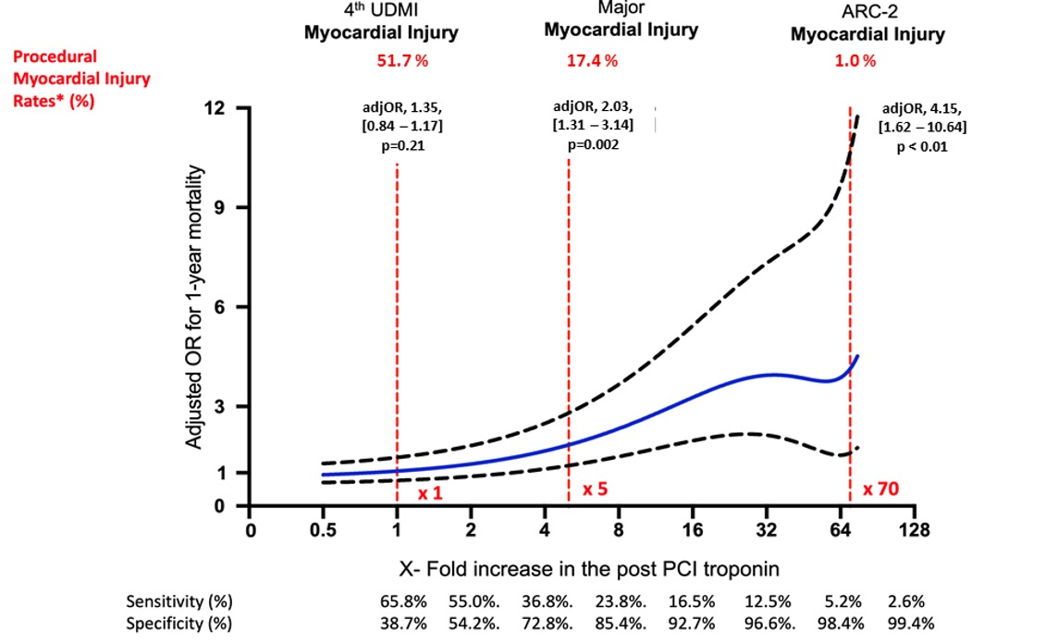
Association with Higher Mortality
N= 9092 Patient level data pooled analysis in CCS patients with normal troponin
ScientificSessions.org
Silvain J et al. Eur Heart J 2020 – in press
#AHA20
Notes:
4

Slide 5
Study Objective
To examine the effect of ticagrelor as compared with clopidogrel to reduce periprocedural myocardial necrosis in stable coronary patients undergoing high-risk elective PCI.
ScientificSessions.org
Silvain J et al. Am Heart J. 2020
#AHA20
Notes:
5

Slide 6


Study organization
Academic Research Organization
Pr Gilles MONTALESCOT (Scientific Director)
Pr Johanne SILVAIN (Principal Investigator)
Pr Eric VICAUT (Méthodologist-statistician)
Abdourahmane DIALLO (Independent Statistician)
Karine BROCHARD (Project Manager)
Martine TANKE (Project Manager)
Sponsor
Assistance Publique des Hôpitaux de Paris
Damien VANHOYE - DRCI
Funding
ACTION fonds and Astra Zeneca
Steering Committee
Pr Johanne SILVAIN (Paris, France )
Pr Gilles MONTALESCOT (Paris, France)
Pr Eric VICAUT (Paris, France )
Pr Guillaume CAYLA (Nîmes, France)
Pr Farzin BEYGUI (Caen, France )
Dr Grégoire RANGE (Chartres, France)
Pr Zuzana MOTOVSKA (Prague, Czech Republic)
DSMB
Pr Philippe Gabriel STEG – Chair
Pr Jean-Sébastien HULOT
Pr Corinne ALBERTI
Members of the Clinical Events Committee
Pr Grégory DUCROCQ
Dr Mikael LAREDO
Dr Raphaelle DUMAINE
ScientificSessions.org
#AHA20
Notes:
6

Slide 7


Study design
N= 1900 troponin negative* or modestly positive patients scheduled for PCI
R
Ticagrelor 180 mg
Clopidogrel LD*
*300 or 600mg at physicians discretion
PCI procedure
44 French PCI Centers
Troponin evaluation post PCI
5 Czech Republic PCI Centers
Primary end-point : MI type 4a, 4b (stent thrombosis) or major myocardial injury at 48 hours or discharge
Ticagrelor MD
90mg x2/day
Clopidogrel MD
75 mg /day
Follow up at 30days for clinical secondary EP
ScientificSessions.org
#AHA20
Notes:
7

Slide 8
Incusion Criteria
Patient related
Age > 75
Creat Clearance < 60ml/min
Diabetes Mellitus
BMI >30
History of ACS in the past 12 months
LVEF <40% and/or prior episode of HF
Male or non-pregnant female ≥ 18 years of age
Undergoing non-emergent PCI
Having at least one high-risk feature
Negative troponin or moderatly positive and decreasing before PCI
Informed consent obtained in writing at enrolment into the study
Procedure related
Multivessel disease
Multiple stents needed
Left main stenting
Bifurcation stenting
ACC/AHA type B2, C lesion
Venous or arterial coronary graft
Key Exclusions: ACS; need for chronic oral anticoagulation; other planned coronary revascularization within 30 days
ScientificSessions.org
Silvain J et al. Am Heart J. 2020
#AHA20
Notes:
8

Slide 9
Sample Size Calculation
Expected events rates : 30% for the primary EP of MI-4/I at 48 hours in the clopidogrel arm
Expected relative risk : 20 % reduction
Power 80% , two-sided alpha level of 5%
856 patients/group required + 10% of dropout rate : 1900 patients required
An interim analysis was performed with no necessary sample size adjustment
Zeitouni M et al. Eur Heart J 2018
ScientificSessions.org
#AHA20

Slide 10
1910 patients underwent randomisation
956 were assigned to the Ticagrelor group
954 were assigned to the Clopidogrel group
13 did not have PCI
2 withdrew consent
9 did not have PCI
2 withdrew consent
1 was randomised twice
941 patients analyzed in the intention to treat and safety populations
942 patients analyzed in the intention to treat and safety populations
Primary outcome at 48 hours
15 patients didn’t complete the Follow up at 30 days because of the following reasons:
n= 2 Death
n= 2 Decision of the investigator
n= 4 Patient refuse to continue the study
n= 1 Patient was lost to follow up
n= 1 Patient released study for SAE
n= 5 Other
7 patients didn’t complete the Follow at 30 days because of the following reasons:
n= 0 Death
n= 0 Decision of the investigator
n= 1 Patient refuse to continue the study
n= 3 Patient was lost to follow up
n= 0 Patient released study for SAE
n= 3 Other
ScientificSessions.org
#AHA20
Notes:
10

Slide 11
Demographics
 | Ticagrelor | Clopidogrel
 | n= 941 | n= 942
Characteristics
Age – years | 66 ± 9·2 | 66·6 ± 9·7
Female sex – no. (%) | 177 (18·8) | 207 (22·0)
Body mass index – kg/m² | 27·8 ± 4·5 | 27·6 ± 4·9
Current Smoker – no. (%) | 166 (17·6) | 171 (18·2)
Hypertension – no. (%) | 594 (63·1) | 607 (64·4)
Diabetes – no. (%) | 328 (34·9) | 352 (37·4)
Dyslipidemia – no. (%) | 581 (61·7) | 570 (60·5)
Renal Insufficiency (Crea Cl < 60ml/min) | 89 (9·5) | 98 (10·4)
Past Medical History- no. (%)
History of ACS | 51 (5·4) | 50 (5·3)
Prior CABG | 62 (6·6) | 60 (6·4)
Prior PCI | 339 (36·1) | 362 (38·4)
Peripheral vascular disease | 121 (12·9) | 115 (12·2)
Prior Stroke or Transient Ischemic Attack | 43 (4·6) | 49 (5·2)
LVEF < 40% and/or prior episode of HF | 46 (4·9) | 49 (5·2)
“the baseline cTn was negative in 93·2% of the patients with no differences between the groups”
 | Ticagrelor | Clopidogrel
 | n= 941 | n= 942
Treatment on admission
Aspirin | 814 (86·5) | 804 (85·4)
Clopidogrel | 388 (41·3) | 417 (44·3)
Procedural Characteristics
Number of high-risk feature | 3·2 ± 1·4 | 3·2 ± 1.5
Radial/Ulnar approach | 891 (94·9) | 895 (94·9)
Multivessel Disease | 575 (61·1) | 586 (62·2)
Number of stents implanted per patient | 1·8 ± 1·0 | 1·8 ± 1·0
Total stent length per patient – mm | 38·4 ± 24·5 | 38·9 ± 24·8
ScientificSessions.org
#AHA20
Notes:
11

Slide 12
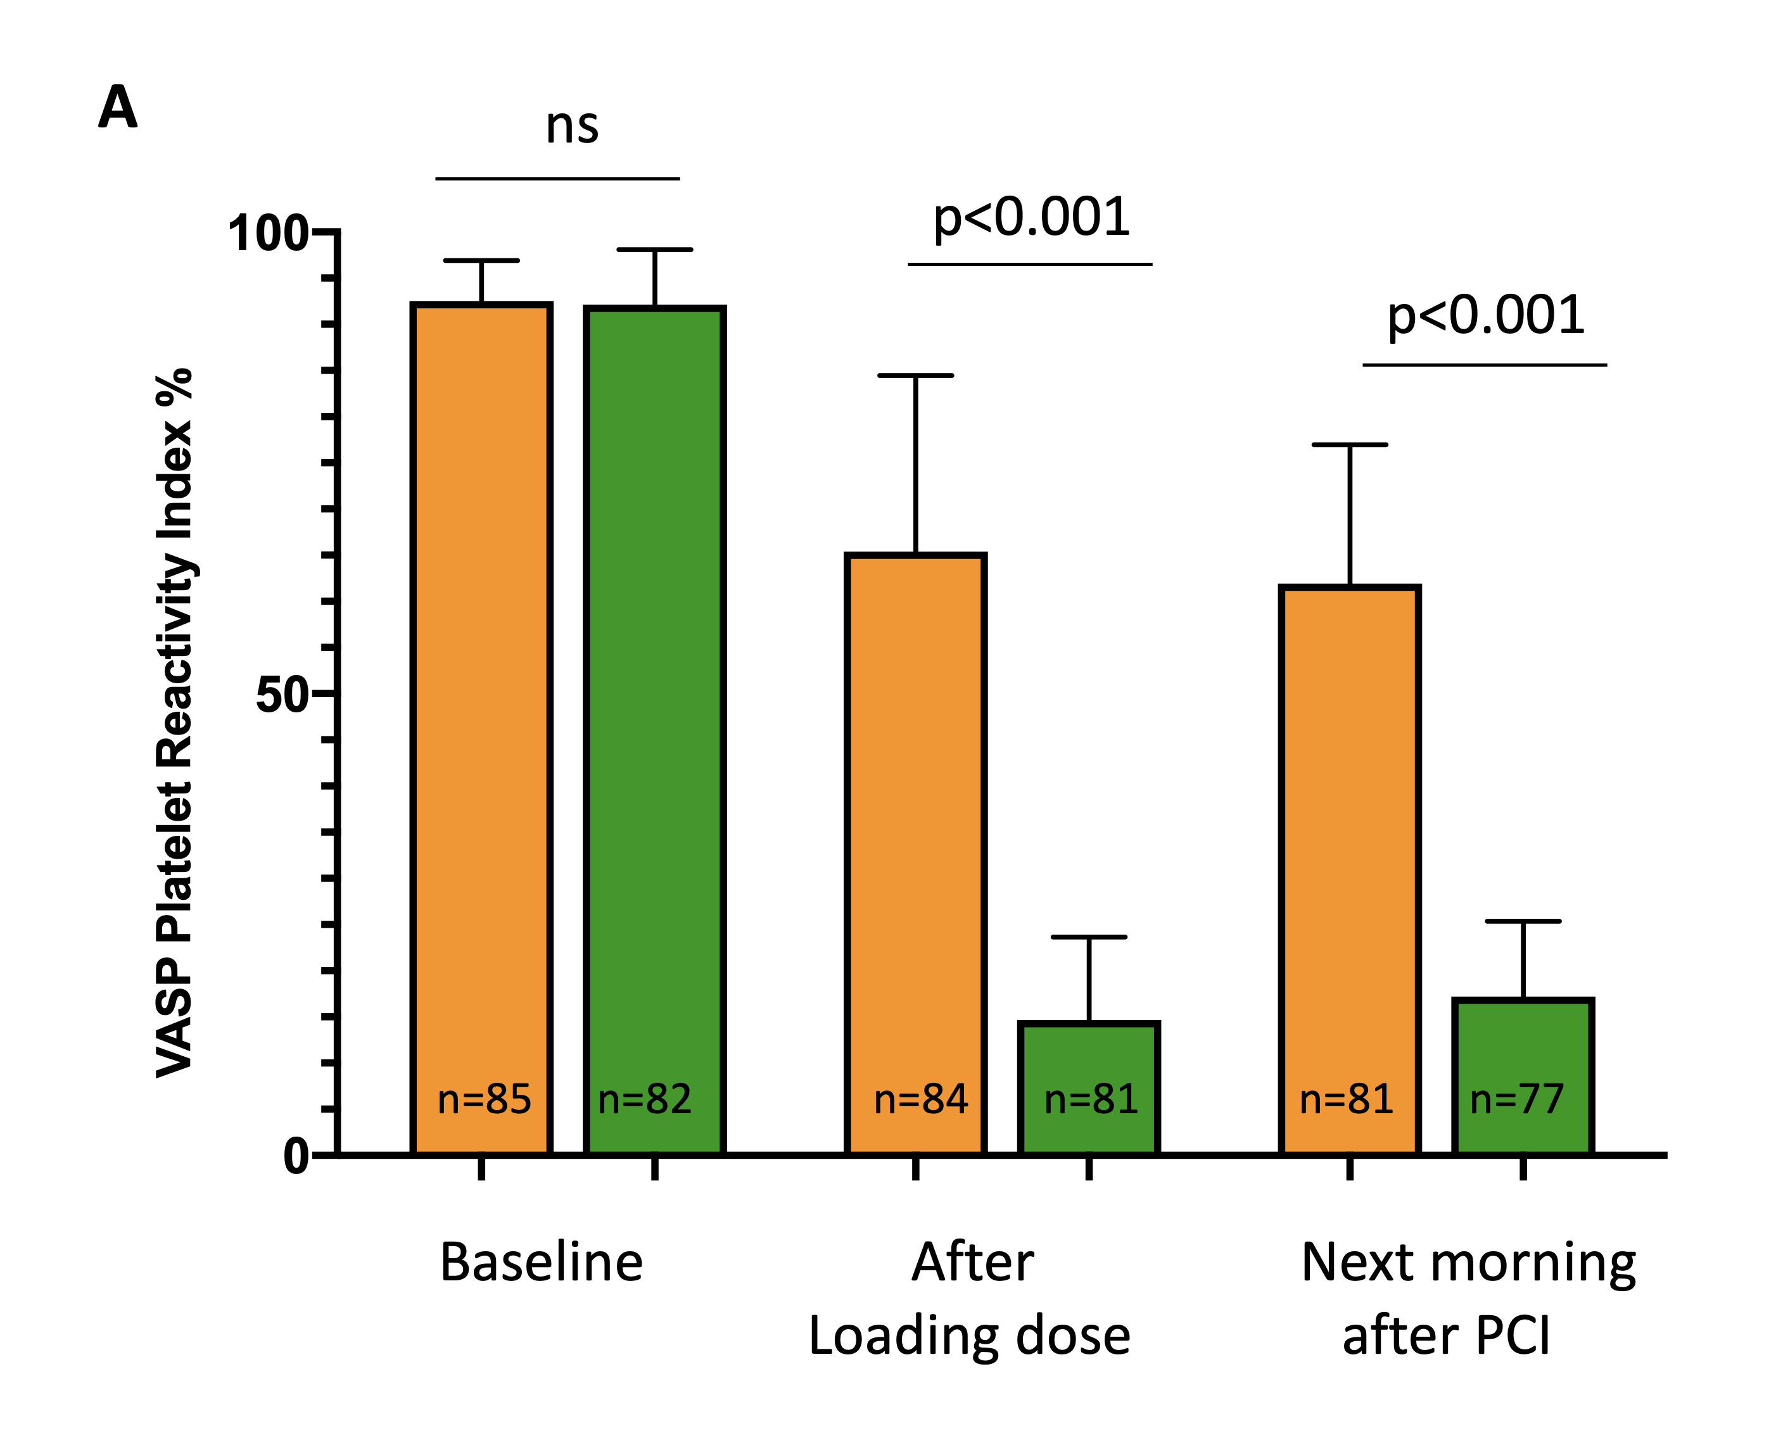
Biological study
Bio-ALPHEUS ancillary PD study performed in 5 centers n= 167 patients
Clopidogrel
Ticagrelor
Analysis of the level of P2Y12 inhibition in a masked fashion at the ACTION central core laboratory (Paris, France)
4 hours after LD
ScientificSessions.org
#AHA20
Notes:
12

Slide 13
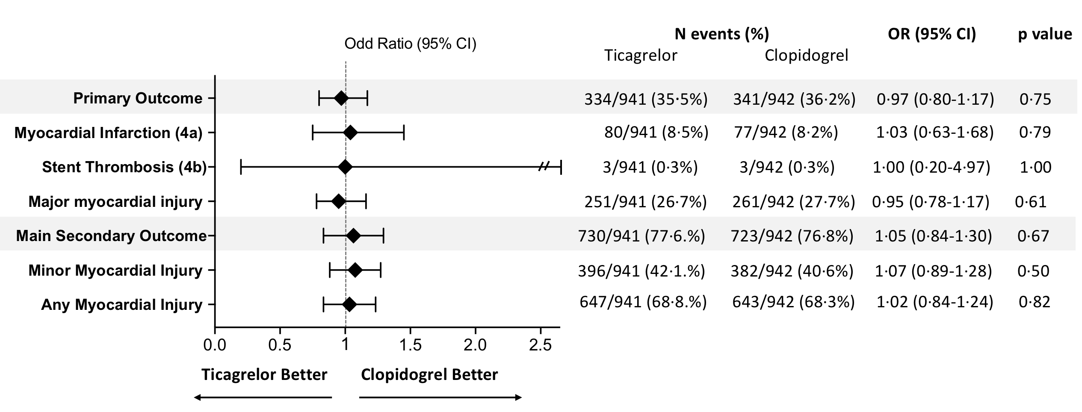
Primary Outcome
†
†3rd Universal definition of MI
Thygesen K et al. Eur Heart J 2012
ScientificSessions.org
#AHA20
Notes:
13

Slide 14
Main Secondary Outcome
‡
‡4th Universal definition of MI
Thygesen K et al. Eur Heart J 2018
ScientificSessions.org
#AHA20
Notes:
14

Slide 15
Clinical Outcomes at 30 days
“death and stroke/TIA were rare events (0·2% vs 0% and 0·2% vs 0·1%) in the ticagrelor and clopidogrel group respectively ”
ScientificSessions.org
#AHA20
Notes:
15

Slide 16
Safety
 | Ticagrelor N=941 | Clopidogrel N= 942 | OR 95% CI | P value
At 48 hours
Major Bleeding Events (BARC 3 or 5) | 1 (0·1%) | 0 (0·0%) | - | 0·50
Nuisance or Minor bleeding (BARC 1 or 2) | 63 (6·7%) | 50 (5·3%) | 1·28 (0·87 – 1·88) | 0·20
Any Bleeding (BARC 1 to 5) | 64 (6·8%) | 50 (5·3%) | 1·30 (0·89-1·91) | 0·17
At 30 days
Major Bleeding Events (BARC 3 or 5) | 5 (0·5%) | 2 (0·2%) | 2·51 (0·49-13·0) | 0·29
Nuisance or Minor bleeding (BARC 1 or 2) | 105 (11·2%) | 71(7·5%) | 1·54 (1·12-2·11) | 0·007
Any Bleeding (BARC 1 to 5) | 110 (11·7%) | 73 (7·7%) | 1·58 (1·15-2·15) | 0·0039
Dyspnea was more frequent in the ticagrelor group (11.2%) as compared with the clopidogrel group (0.5%) and lead to more frequent discontinuation of the study drug (2.2% vs. 0.4%) for each group respectively.
ScientificSessions.org
#AHA20
Notes:
16

Slide 17
Limitations
Open label trial
Sensitive endpoint (periprocedural MI and myocardial injury)
Patients under chronic clopidogrel therapy included
All troponin assays authorized to reflect real-life
ScientificSessions.org
#AHA20
Notes:
17

Slide 18
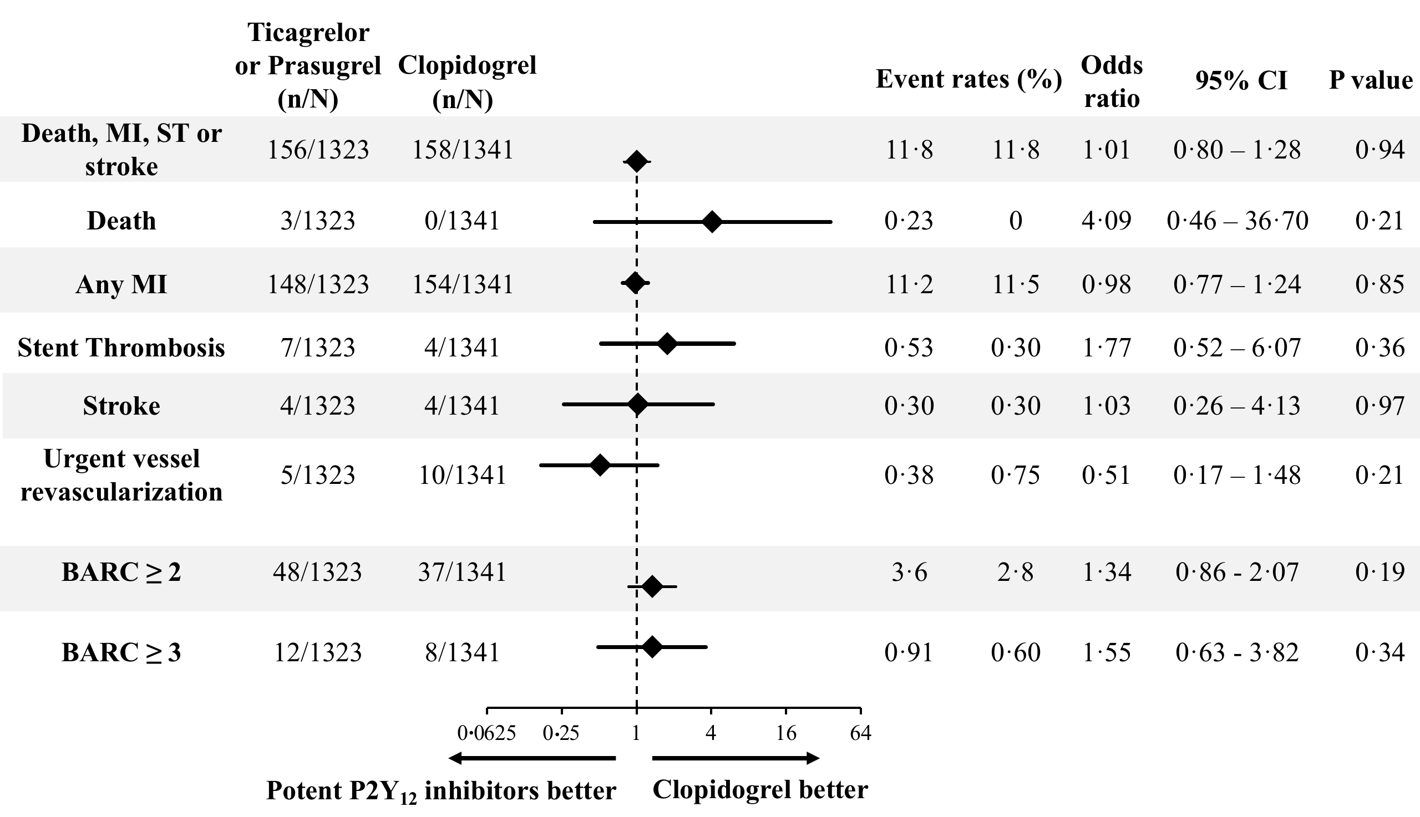
Pooled Analysis n=2654 patients
SASSICAIA trial (Prasugrel) – ALPHEUS trial (Ticagrelor)
781 patients
1883 patients
SASSICAIA - Mehilli J. Circulation: Cardiovascular Interventions. 2020
ScientificSessions.org
#AHA20

Slide 19
Conclusion
Higher level of platelet inhibition obtained with ticagrelor, does not translate into a reduction of periprocedural MI or myocardial injury within 48 hours of high-risk PCI performed in stable coronary patients.
None of the clinical outcomes differed between groups at 30-day follow-up.
Ticagrelor use for 30 days did not translate in increased major bleeding rate but there was an excess of minor bleeding and dyspnea.
ScientificSessions.org
#AHA20
Notes:
19

Slide 20
Thanks all ALPHEUS Investigators
and supporting team
Julien | ADJEDJ | Nassim | BRAIK | Nicolas | DELARCHE | Petr | JERABEK | Thibault | MANIGOLD | Etienne | PUYMIRAT | Jean Richard | VI-FANE
Franck | ALBERT | Marian | BRANNY | Cédric | DELHAYE | François | JOURDA | Stéphane | MANZO-SILBERMAN | Grégoire | RANGE | Flavien | VINCENT
Aimé | AMONCHOT | Erwan | BRESSOLLETTE | Thibault | DEMICHELI | Petr | KALA | Marco | MENNUNI | Jack | RAVISY | Wael | YAFI
Yann | ANCEDY | Clément | BRIET | François | DERIMAY | Jan | KANOVSKÝ | Antoine | MERLET | Olivier | RESSENCOURT | Michel | ZEITOUNI
Pierre | ARDOUIN | Philppe | BRUNEL | Alain | DIBIE | Nicole | KARAM | Marc | METGE | Michal | REZEK | Mami | ZOHEIR
Marc-Antoine | ARNOULD | Damien | BRUNET | Jean-Guillaume | DILLINGER | Jiří | KARASEK | Laurent | MOCK | Carole | RICHARD
David | ATTIAS | Philippe | BUFFET | Laurie | DUFOUR | Alain | KERMARREC | Guillaume | MOLINS | Gilles | RIOUFOL
Vincent | AUFFRET | Léa | CACOUB | Stéphane | EDERHY | Mathieu | KERNEIS | Gilles | MONTALESCOT | François | ROUBILLE
Nicolas | BARON | Romain | CADOR | Rami | EL MAHMOUD | Martin | KOZEL | Jacques | MONTSEGU | Vincent | ROULE
Olivier | BARTHELEMY | Francisco | CAMPELO-PARADA | Arnaud | ETIENNEY | Pavel | KUKLA | Olivier | MOREL | Laurent | ROUSSEL
Anne | BELLEMAIN-APPAIX | Max | CARRE | Benjamin | FAURIE | Jean-Noël | LABEQUE | Zuzana | MOTOVSKA | Rémi | SABATIER
Reda | BENSAID | Max | CARRE | Emmanuelle | FILIPPI | Alexandre | LAFONT | Pascal | MOTREFF | Christophe | SAINT-ETIENNE
Pauline | BERTHOME | Didier | CARRIE | Romain | GALLET | Elisa | LARRIEU-ARDILOUZE | Gauthier | MOUILLET | François | SCHIELE
Mathieu | BESUTTI | Christophe | CAUSSIN | Jean-Louis | GEORGES | Benoit | LATTUCA | Karim | MOUSSA | Laurent | SCHMUTZ
Farzin | BEYGUI | Guillaume | CAYLA | Géraldine | GIBAULT-GENTY | Hervé | LE BRETON | Thomas | MOUYEN | Jiri | SEMENKA
Mathieux | BIGNON | Laura | CETRAN | Jens | GLASENAPP | Christophe | LE RAY | Jan | MROZEK | Georgios | SIDERIS
Nathaniel | BITTON | Stephen | CHASSAING | Marc | GORALSKI | Florence | LECLERCQ | Mohammed | NEJJARI | Johanne | SILVAIN
Katrien | BLANCHART | Marion | CHAUVET | Pascal | GOUBE | Bertrand | LEDERMANN | Martin | NOVAK | Jan | SITAR
Elodie | BLICQ | Thomas | CHOLLET | Tomas | GREZL | Claude | LEFEUVRE | Mathieu | PANKERT | Géraud | SOUTEYRAND
Franck | BOCCARA | Rémi | CHOUSSAT | Marie | HAUGUEL-MOREAU | Adrien | LEMAITRE | Michel | PANSIERI | Vincent | SPAGNOLI
Otakar | BOCEK | Luc | CHRISTIAENS | Gérard | HELFT | Gilles | LEMESLE | Laurent | PAYOT | Christian | SPAULDING
Jean-Luc | BONAS | Jérôme | CLERC | Patrick | HENRY | Vincent | LETOCART | Katy | PETIT | Hugues | SPILLEMAEKER
Mickael | BONIN | Jean-Philippe | COLLET | Sébastien | HESS | Thibault | LHERMUSIER | Fabien | PICARD | Mathieu | STEINECKER
Jean-Louis | BONNET | Nicolas | COMBARET | Ota | HLINOMAZ | Isabelle | LHUILLIER | Julien | PLESSIS | Zdenko | STELMACH
Lionel | BONNEVIE | Luc | CORNILLET | Sylvie | HRUSKOVA | Bernard | LIVAREK | Leos | PLEVA | Roman | ŠTIPAL
Ziad | BOUERI | Pierre | COSTE | François | HUCHET | Damien | LOGEART | Martin | POLOCZEK | Emmanuel | TEIGER
Karim | BOUGRINI | Yves | COTTIN | François | HUCHET | Aurelie | LOIRAT | Sina | POROUCHANI | Christophe | THUAIRE
Frédéric | BOUISSET | Thomas | CUISSET | Vincent | HUMEAU | Clément | LONJON | Martin | PORZER | Eric | VAN BELLE
Madjid | BOUKANTAR | Philippe | DEGRELL | Karl | ISAAZ | Luc | LORGIS | Christophe | POUILLOT | Olivier | VARENNE
Dominique | BOULMIER | Pierre | DEHARO | Laurent | JACQ | Luc | MAILLARD | Emmanuel | POULIDAKIS | Aurelie | VEUGEOIS
ScientificSessions.org
#AHA20
Notes:
20

Slide 21

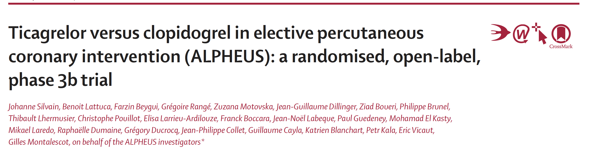
@docjohanne
www.action-coeur.org
ScientificSessions.org
Lancet 2020 November 14, 2020
#AHA20
Notes:
21

Slide 22

ALPHEUS
Assessment of Loading with the P2Y12 inhibitor ticagrelor or clopidogrel to Halt ischemic Events in patients Undergoing elective coronary Stenting
Johanne Silvain MD-PhD, Guillaume Cayla MD-PhD, Farzin Beygui MD-PhD, Grégoire Rangé MD, Zuzana Motovska MD-PhD,
Eric Vicaut MD-PhD and Gilles Montalescot MD-PhD
on behalf of the ALPHEUS investigators
www.action-cœur.org
ClinicalTrials.gov number, NCT02617290.
@docjohanne
ScientificSessions.org
action-coeur.org
#AHA20

