Slide 1
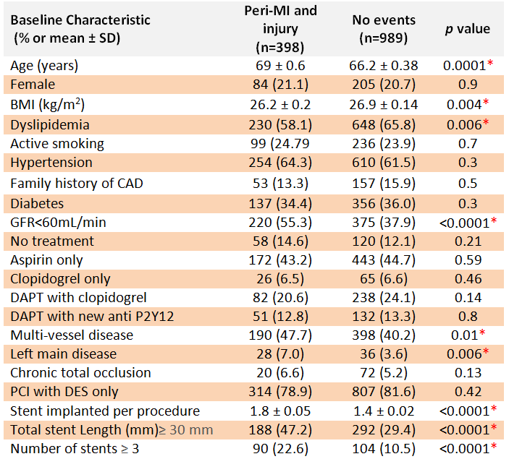
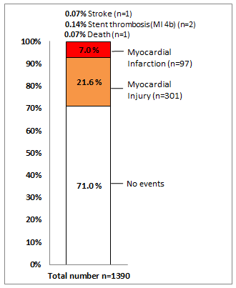
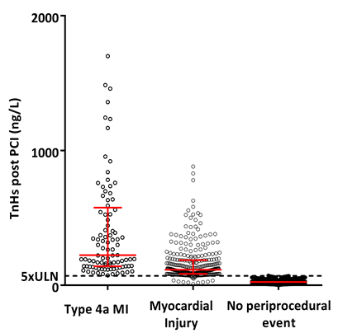
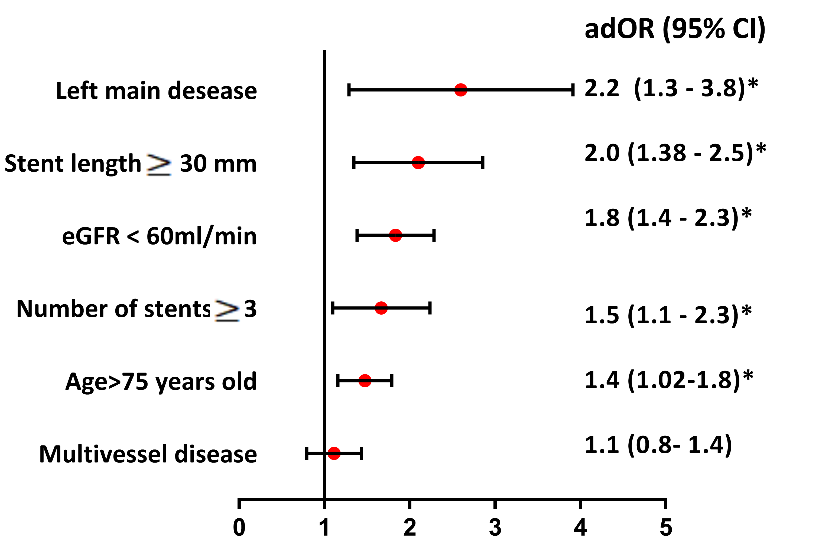
Michel Zeitouni, Johanne Silvain*, Mathieu Kerneis, Olivier Barthelemy, Remi Choussat, Marie Hauguel-Moreau, Gerard Helft, Claude Le Feuvre,
Jean-Philippe Collet, Gilles Montalescot *johanne.silvain@aphp.fr www.action-coeur.org
Should we care about post-procedural troponin in elective coronary stenting ?
Abstract
Background Periprocedural myocardial infarction (MI) and injury (Mi) are frequent after elective percutaneous coronary intervention (PCI) and remain a clinical challenge.
Purpose To assess the rate, risk factors, treatments and prognosis of periprocedural MI and of Mi defined according to the Third Universal definition of MI in patients undergoing elective PCI.
Methods We screened and included all patients with a negative troponin level before PCI who underwent an elective PCI during 2014 and 2015 at our institution. Periprocedural complication was defined as the composite of non-fatal PCI-related MI (type 4a or 4b) and Mi evaluated at 48 hours or at discharge if it occurred earlier. Multivariate analysis was performed to identify independent predictors of periprocedural complications. Follow-up was performed at 30 days and all ischemic events (death, re-MI, urgent re-vascularization, stroke) and re-hospitalization were evaluated. We also assessed off-label prescription of ticagrelor and prasugrel in this indication of elective PCI.
Results Of the 1390 elective PCI patients, 28.74% had a periprocedural complications including 0.14% of stent thrombosis (MI type 4b), 7.0% of type 4a MI and 21.6% of Mi. Risk factors for periprocedural complications were age >75, low creatinine clearance (GFR<60ml/min), use of rotablator, treatment of the left main artery, multiple stenting and total stent length >30mm. Patients with periprocedural MI or Mi had higher rate of cardiovascular events at 30 days (HR 4.9, CI 2.3-10.5, p<0.0001)(see figure). Ticagrelor or prasugrel were prescribed at discharge in 23.1% patients of these patients.
No conflict of interest to disclose.
Pitié-Salpêtrière Hospital, Sorbonne Université Paris 6 (UPMC), ACTION Study Group, INSERM UMRS_1166, Institut de Cardiologie, Paris, France
Figure 1 : Flow-Chart of the study
Table 1. : Baseline characteristics
Figure 2 : Periprocedural ischemic events within 48 hours after PCI
n=8475 patients
For angiogram in 2014 and 2015
n=5059 angiogram alone
Intended PCI n=3416 patients
n= 1750 PCI for ACS
-STEMI n=688, NSTEMI n=918
-Cardiac arrest n=69
-Shock n=75
Intended elective PCI : n =1666
n=276 patients
without troponin after PCI
N=1390 elective PCI patients with normal troponin level at admission
Figure 2 : Troponin level in type-4a MI and Mi
Figure 4: Survival without cardiovascular events at 30 days.
Figure 3 : Risk factors for type 4a-MI and Mi
Conclusion Periprocedural myocardial infarction and injury are frequent in elective PCI patients and are associated with worse outcome at one-month follow-up. Stronger P2Y12 inhibition during elective PCI could be an alternative to decrease these events and is being evaluated in the randomized ALPHEUS Trial (NCT02617290, n=1900 patients)

