Slide 1
When should we start a P2Y₁₂ inhibitor in patients with an acute coronary syndrome?
G. Montalescot
Dr. Montalescot reports research Grants to the Institution or Consulting/Lecture Fees from ADIR, Amgen, AstraZeneca, Bayer, Berlin Chimie AG, Boehringer Ingelheim, Bristol-Myers Squibb, Beth Israel Deaconess Medical, Brigham Women’s Hospital, Cardiovascular Research Foundation, Celladon, CME Resources, Daiichi-Sankyo, Eli-Lilly, Europa, Elsevier, Fédération Française de Cardiologie, Fondazione Anna Maria Sechi per il Cuore, Gilead, ICAN, Janssen, Lead-Up, Menarini, Medtronic, MSD, Pfizer, Sanofi-Aventis, The Medicines Company, TIMI Study Group, WebMD.
Notes:
1

Slide 2
The concept…

Slide 3
Definition of Pre-treatment
Working diagnosis of ACS
Invasive strategy decided
On aspirin + anticoagulation
ER-CCU
→ P2Y₁₂ antagonist given before coronary visualization
PCI → benefit expected
Medical treatment → ?
CABG → no benefit expected
Other diagnosis (pericarditis, aortic dissection, heart failure, LVH, pulmonary embolism, GI ulcer, pancreatitis...) → harm expected
Cath Lab

Slide 4
The concept…was never proved

Slide 5

ACCOAST: The only prospective trial in NSTEMI to investigate pre-treatment with a P2Y₁₂-receptor antagonist
A comparison of prasugrel at the time of percutaneous coronary intervention (PCI) or as pre-treatment at the time of diagnosis in patients with non-ST elevation myocardial infarction
CV Death, MI, Stroke
Randomised, N=4038
15
HR 1.00
(95% CI: 0.79–1.28)
p=0.98
HR 0.98
(95% CI: 0.78–1.23)
p=0.86
Treated, n=4033
10
No pre-treatment
n=1996
Pre-treatment
n=2037
No pre-treatment
7.2
No pre-treatment
6.4
Endpoint (%)
Pre-treatment
7.1
5
Pre-treatment
6.4
The rate of the primary efficacy endpoint (death from CV causes, MI, stroke, urgent revascularisation, or glycoprotein inhibitor rescue therapy) through Day 7, did not differ significantly between the groups
(HR 1.02; 95% CI: 0.84–1.25; p=0.81)
0
0
5
10
15
20
25
30
No. at risk:
No pre-treatment
Pre-treatment
Days from first dose
1996
2037
1854
1892
1843
1881
1838
1874
1832
1872
1823
1867
1691
1687
Montalescot et al. N Engl J Med 2013;369:999–1010

Slide 6
ACCOAST: Pre-treatment showed similar efficacy but an increase in TIMI major bleeding
The rate of TIMI major bleeding episodes through Day 7 was increased
with pre-treatment (HR 1.90; 95% CI: 1.19–3.02; p=0.006)
Total
patients
4033
2781
238
Pre-tx
n (%)
52 (2.55)
22 (1.57)
25 (20.66)
No pre-tx
n (%)
27 (1.35)
11 (0.80)
16 (13.68)
Hazard Ratio
(95% CI)
1.90 (1.19–3.02)
1.98 (0.96–4.09)
1.59 (0.85–2.98)
Overall (pre-treatment
vs no pre-treatment)
PCI
CABG
0.2
0.5
1
2
5
10
15
Pre-treatment better
No pre-treatment better
Montalescot et al. N Engl J Med 2013;369:999–1010 (suppl)

Slide 7
ACCOAST: Is there a risk of waiting angio to treat?
Primary efficacy endpoint prior to angiography
4
No pre-treatment
3.2
3
p=0.926
Endpoint (%)
Pre-treatment
2.5
2
1
CV death, MI, stroke,
UR, GPIIb/IIIa bailout
preangiography
0
0
1
2
Days from first dose
No. at risk:
No pre-treatment
Pre-treatment
1981
2014
134
113
134
113
Montalescot G et al – ACCOAST Unpublished data

Slide 8
ACCOAST: Are the results different for PCI patients?
PCI cohort
10
CV death, MI or stroke
Pre-treatment
9.2
8.5
8.8
HR 1.01
(95% CI: 0.78–1.31)
p=0.92
No pre-treatment
HR 1.05
(95% CI: 0.82–1.34)
p=0.72
8.4
Endpoint (%)
Non-CABG-related TIMI
major or minor bleeding
5
4.2
3.4
Pre-treatment
HR 3.11
(95% CI: 1.86–5.22)
p<0.001
HR 2.94
(95% CI: 1.67–5.18)
p<0.001
No pre-treatment
1.4
1.2
0
0
5
10
15
20
25
30
Days from first dose
Montalescot et al. J Am Coll Cardiol 2014;64:2563–71

Slide 9
The controversy…

Slide 10
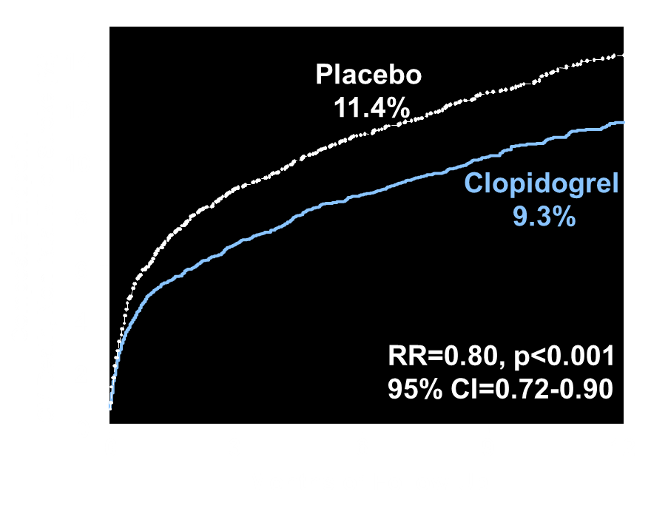

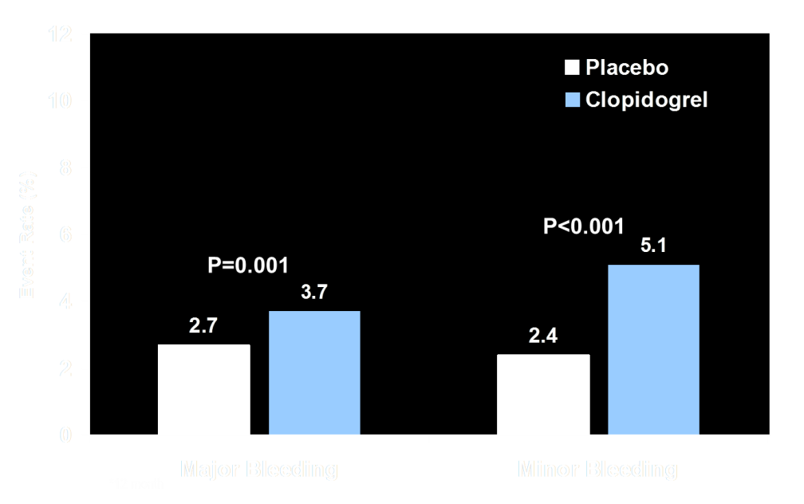

ACS
CURE Efficacy
57% no cath…
20% PCI
CURE Safety*
When cath, 10 days waiting …
Yusuf S, et al. N Engl J Med 2001;345:494-502
Notes:
Indeed, although not powered to show a difference in ischemic endpoints, the group of patients loaded with 300mg of clopidogrel at least 6 hours before PCI experienced a 38·6% decrease in MACE that reached significance in those pre-treated ≥15h before the procedure

Slide 11
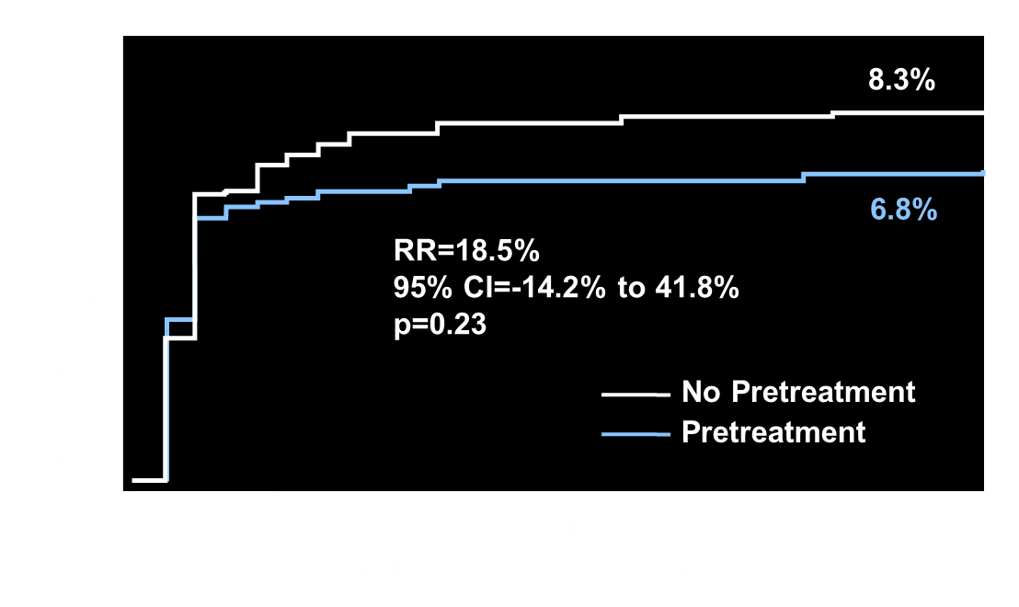
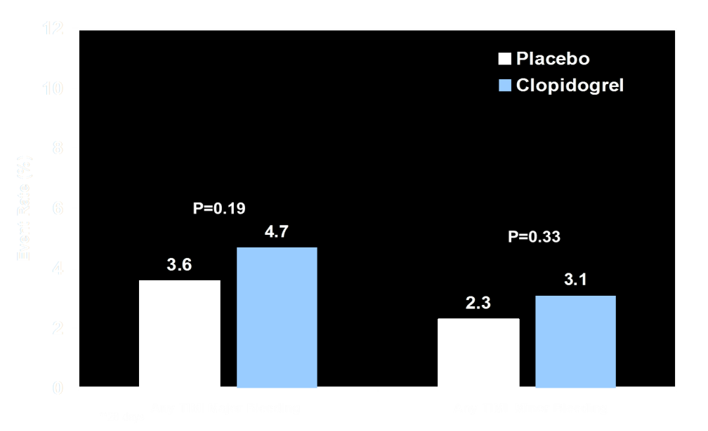
ACS
CURE Efficacy
CREDO Efficacy
PCI
CURE Safety*
CREDO Safety**
Yusuf S, et al. N Engl J Med 2001;345:494-502
Steinhubl SR, et al. JAMA 2002;288:2411-2420
Notes:
Indeed, although not powered to show a difference in ischemic endpoints, the group of patients loaded with 300mg of clopidogrel at least 6 hours before PCI experienced a 38·6% decrease in MACE that reached significance in those pre-treated ≥15h before the procedure

Slide 12
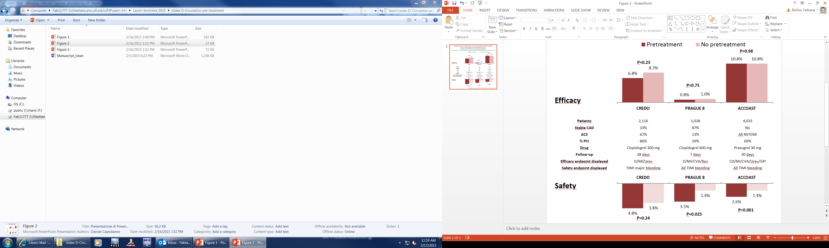
Studies of pretreatment with oral P2Y₁₂ receptor inhibitors in patients with stable CAD and NSTE-ACS
Capodanno D & Angiolillo DJ. Circ Cardiovasc Interv 2015

Slide 13
Randomized studies only (PCI patients)
Bellemain-Appaix A et al. BMJ 2014

Slide 14
Randomized studies only (All patients)
Harmful
Bellemain-Appaix A et al. BMJ 2014

Slide 15
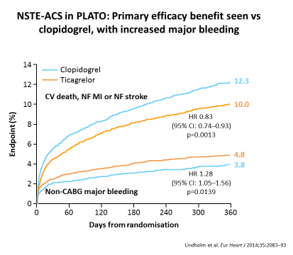
Ticagrelor in ACS: PLATO
All patients were pretreated before the angiogram…
Cath 74%
PCI 46%

Slide 16
The controversy… was seen before

Slide 17
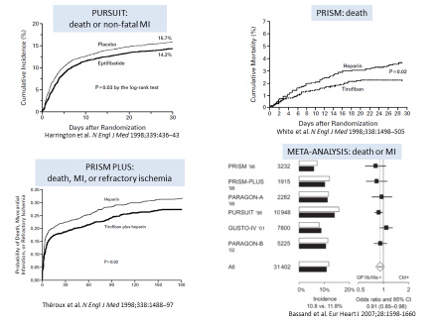
GPIs in NSTE-ACS

Slide 18
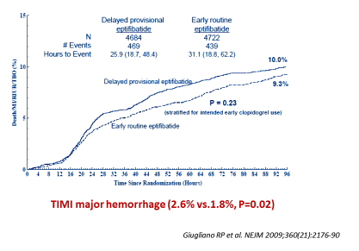
EARLY-ACS: GPI pre-treatment vs. no pre-treatment

Slide 19
The controversy…in the guidelines

Slide 21
GPI pre-treatment in NTE-ACS
ACUITY timing
EARLY ACS
Class III
0.25
0.5
1.0
2.0
4.0
30-day death or MI
Windecker et al. Eur Heart J 2014;35:2541–619

Slide 22

SCAD Guidelines
Pretreatment with clopidogrel (when coronary anatomy is not known) is not recommended. | III | A
Revasc Guidelines
NSTE-ACS: It is recommended to give P2Y₁₂ inhibitors at the time of first medical contact | I | B
Pretreatment with prasugrel in patients in whom coronary anatomy is not known, is not recommended | III | B
NSTE-ACS Guidelines
A P2Y₁₂ inhibitor is recommended, in addition to aspirin, for 12 months unless there are contra-indications such as excessive risk of bleeds.. | I | A
It is not recommended to administer prasugrel in patients in whom coronary anatomy is not known. | III | B
DAPT Guidelines
In patients with SCAD pre-treatment with clopidogrel may be considered if the probability of PCI is high. | IIb | C
Pre-treatment with a P2Y12 inhibitor is generally recommended in patients in whom coronary anatomy is known and the decision to proceed to PCI is made as well as in patients with STEMI | I | A
In NSTE-ACS patients undergoing invasive management, ticagrelor or clopidogrel if ticagrelor is not an option, should be considered as soon as the diagnosis is established. | IIa | C
In NSTE-ACS patients it is not recommended to administer prasugrel in patients in whom coronary anatomy is not known. | III | B

Slide 23


Slide 24
Applying the evidence

Slide 25
NSTE-ACS in the Real World of All-Comers
→ Shall we treat them all before the angio?
Collet JP et al. Circulation. 2014;130:1904-1914

Slide 26

Clinical situations where administration of antiplatelet therapy is delayed
Intubated patient
Vomiting, dysphagia…
STEMI and limited pre-hospital care
NSTE-ACS or SCAD → no pre-treatment
Notes:
The ODT may be beneficial where there is a delay in administration of an oral antiplatelet (OAP), but there is no evidence that it can address a delayed onset of action of an OAP

Slide 27
CHAMPION-PHOENIX: IV P2Y12 inhibitor cangrelor
Death/ MI/ IDR/ Stent Thrombosis within 48 Hours
Bhatt DL et al. N Engl J Med 2013; 368: 1303-1313

Slide 28
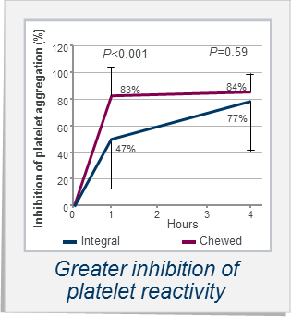

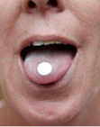
Crushed, chewed or orodispersible
Ticagrelor
Prasugrel
Venetsanos D et al.
Thromb Res 2017;149:88–94
Asher E et al.
Thromb Haemost 2017
Rollini F et al.
JACC 2016

Slide 29
Conclusions
When should we start a P2Y₁₂ inhibitor?
Guidelines uncertain: LOE B for prasugrel / LOE C for ticagrelor and clopidogrel
Bleeding risk increases with early administration
Ischemic risk reduction is uncertain
Early start more justified when long wait (>48hrs) for cath or no cath strategy
Start after angio more justified when expeditive care with preferred use of crushed pills or IV P2Y12 inhibitor

