Slide 1
Anti-thrombotic treatment after TAVR: insights from the FRANCE-TAVI Registry
Pavel OVERTCHOUK
Paul GUEDENEY
Stéphanie ROUANET
Jean Philippe VERHOYE
Thierry LEFEVRE
Eric VAN BELLE
Helene ELTCHANINOFF
Martine GILARD
Pascal LEPRINCE
Bernard IUNG
Olivier BARTHELEMY
Géraud SOUTEYRAND
Eric VICAUT
Gilles MONTALESCOT
Hervé LE BRETON,
Jean-Philippe COLLET*
Jean-Philippe COLLET Jean-philippe.collet@psl.aphp.fr
Sorbonne Université_Action Study Group (action-cœur.org)_Head of the INSERM UMRS 1166 on thrombosis and of the Cathleterization Laboratory_Institut de Cardiologie (APHP)_Pitié-Salpêtrière_Paris, France
COI: Dr Collet has received research grants from Bristol-Myers Squibb; consulting fees from Sanofi-Aventis, Eli Lilly, and Bristol-Myers Squibb; and lecture fees from Bristol-Myers Squibb, Sanofi-Aventis (action-coeur.org).

Slide 2
Management of antithrombotics in patients with TAVI
Bioprosthesis | Class | Level
Anticoagulation
DAPT should be considered for the first 3–6 months after TAVI, followed by lifelong SAPT in patients who do not need OAC for other reasons. | IIa | C

Slide 3
Management of antithrombotics in patients with TAVI
Bioprosthesis | Class | Level
Anticoagulation
SAPT may be considered after TAVI in the case of high bleeding risk. | IIb | C
OAC may be considered for the first 3 months after surgical implantation of an aortic bioprosthesis. | IIb | C

Slide 4
Determinants of Antithrombotic Tx?
1/3→ SCAD or stent PCI
1/3 → Secondary prevention for stroke
2/5 → Permanent AF or NOAF
30%→ Antiplatelet Therapy alone
50% → Oral Anticoagulation alone
25% → OAC + APT

Slide 5
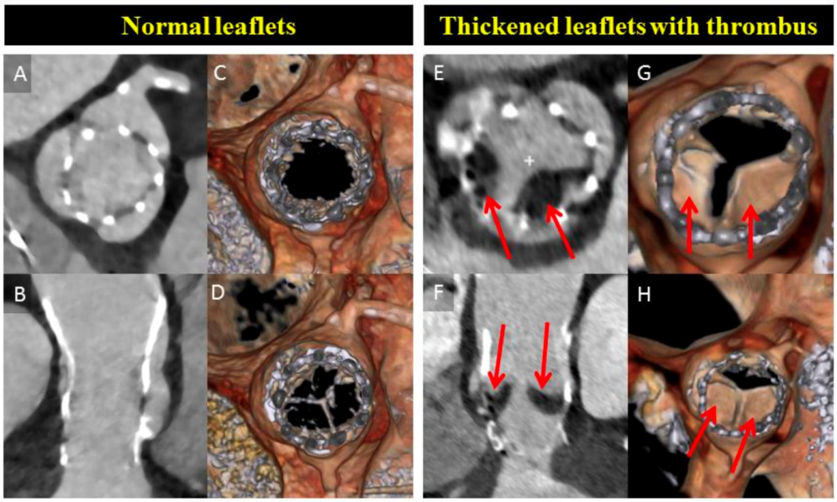
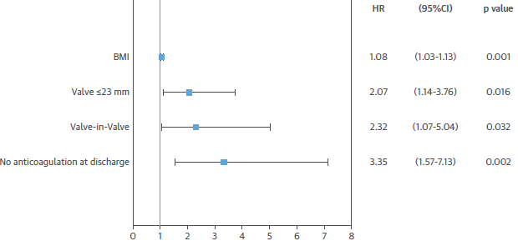
Bioprosthetic Valve Dysfunction
 in mean gradient (MG) ≥ 10 mmHg or new MG ≥ 20mmHg
Prevalence of 4.5% post-TAVR
Makkar et al, NEJM, 2015
Del trigo et al, JACC, 2016

Slide 6
Objectives
To investigate whether anti-thrombotic treatment influences long-term mortality and early bioprosthetic valve dysfunction* ( prosthetic gradient ≥10 mmHg or new gradient≥20 mmHg)
To explore independent correlates of long-term mortality and early BVD after TAVI.
*Eur. Heart J. 2017;38:3382–3390

Slide 7
Study Oversight
Nation-wide France-Tavi Registry*
Sponsors→ Société Française de Cardiologie
Fundings → Edwards Life Science, Medtronic, Action-Coeur
Statistical Analysis → StatEthic and Action-Coeur
*Auffret, V. et al. J Am Coll Cardiol. 2017;70(1):42–55.

Slide 8
Methods
Database: FRANCE TAVI
Inclusion→ multi-centre, French, prospective, registry
Period → January 2013 and December 2015
Mortality outcome → INSEE query on April 12th 2016
BVD → Echocardiographic follow-up to May 9th, 2016
Statistical analysis
Missing values → multiple imputation (sensitivity analysis and complete cases)
Multivariable Cox regression for mortality
Multivariable logistic regression for Bioprosthetic Valve Dysfunction
IBM SPSS Version 23.0 (Armonk, NY: IBM Corp) software

Slide 9
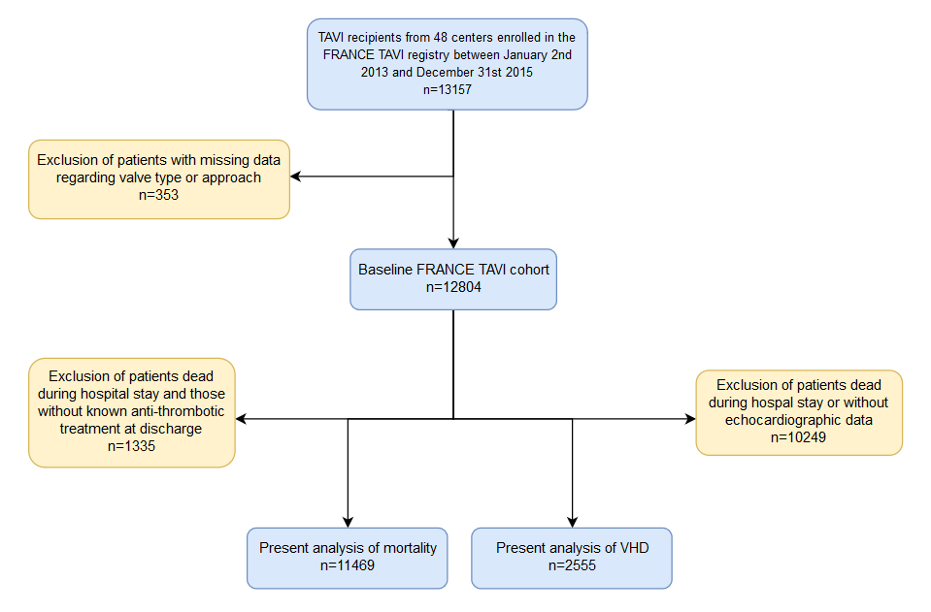
Flow Chart

Slide 10
Patients Characteristics
Characteristics * | Total (n=11469) | No OAC (n=7633) | OAC (n=3836) | P value
Age | 82.8 (0.068) | 82.7 (0.085) | 82.9 (0.111) | 0.6
BMI (kg/m²) | 26.7 (0.056) | 26.6 (0.070) | 26.9 (0.094) | <0.001
Gender (male) | 5683 (49.6) | 3712 (48.6) | 1971 (51.4) | 0.005
NYHA class III-IV | 7941 (68.9) | 5214 (68.2) | 2727 (71) | 0.002
Logistic Euroscore I | 17.8 (0.114) | 17.3 (0.139) | 18.9 (0.198) | <0.001
Prior CABG | 1327 (11.6) | 906 (11.9) | 421 (11) | 0.34
Prior TAVR | 114 (1.0) | 71 (0.9) | 43 (1.1) | 0.17
Prior non-CABG surgery | 798 (6.9) | 457 (6.0) | 341 (8.9) | <0.001
* Data are number (%) or mean+-standard error

Slide 11
Patients Characteristics
Characteristics | Total (n=11469) | No OAC (n=7633) | OAC (n=3836)
Chronic renal failure (eGFR<60mL/min) | 5069 (44.2) | 3232 (42.3) | 1837 (47.9) | <0.001
Atrial fibrillation | 3789 (33.0) | 1066 (14.0) | 2723 (70.8) | <0.001
LVEF (%) | 55.4 (0.128) | 56.1 (0.150) | 53.8 (0.217) | <0.001
Non-femoral access | 1895 (16.5) | 1194 (15.6) | 701 (18.3) | <0.001
Self-expandable (vs balloon) valve | 4045 (35.3) | 2714 (35.6) | 1331 (34.7) | 0.37
Prosthesis diameter ≤23 mm | 3215 (28.2) | 2258 (29.6) | 957 (24.9) | <0.001
AR moderate to severe post-TAVR | 1151 (10.0) | 758 (10) | 393 (10.3) | 0.6
Aspirin at discharge | 9554 (83.3) | 7123 (93.3) | 2431 (63.4) | <0.001
Dual therapy | 2100 (18.3) | 0 | 2100 (54.7) | <0.001
Triple Therapy | 331 (2.9) | 0 | 331 (8.6) | <0.001
* Data are number (%) or mean+-standard error

Slide 12
Correlates of Long-Term Mortality
N=11469 | MI p-value | Adj. HR | 95%CI lower | 95%CI upper
Gender (male) | <0.001 | 1.63 | 1.44 | 1.84
NYHA III or IV | <0.001 | 1.28 | 1.14 | 1.46
Euroscore I | <0.001 | 1.01 | 1.01 | 1.02
Prior CABG | <0.001 | 0.64 | 0.54 | 0.77
Prior non-CABG cardiac surgery | <0.001 | 0.59 | 0.46 | 0.76
Diabetes | <0.001 | 1.25 | 1.12 | 1.41
Moderate/severe renal failure | <0.001 | 1.37 | 1.23 | 1.53
Atrial fibrillation | <0.001 | 1.41 | 1.23 | 1.62
Non-femoral access for TAVR | 0.011 | 1.18 | 1.04 | 1.35
Moderate to severe prosthetic regurgitation | 0.001 | 1.28 | 1.11 | 1.50
Anticoagulation at discharge | 0.013 | 1.18 | 1.04 | 1.35
Auto-expandable (vs balloon) valve | 0.014 | 1.15 | 1.03 | 1.29
Prosthesis diameter 23 mm or less | 0.042 | 1.17 | 1.01 | 1.36

Slide 13
KM Curves According to Anticoagulation

Slide 14
Correlates of Bioprosthetic Valve Dysfunction
N=2555 | m=20 P-value | Adj. OR | 95% CI upper | 95% CI lower
BMI | 0.002 | 1.05 | 1.02 | 1.09
Prior TAVR | 0.025 | 2.96 | 1.15 | 7.64
Moderate/severe renal failure | 0.034 | 1.46 | 1.03 | 2.08
Non-femoral access | 0.049 | 0.53 | 0.28 | 1.02
Prosthesis ≤23 mm | <0.001 | 3.43 | 2.41 | 4.89
OAC at discharge | 0.005 | 0.54 | 0.35 | 0.82

Slide 15
Discussion
Post-TAVI ATT → Driven by patients characteristics
OAC → Less BVD → Potential clinical benefit?
OAC use → Colinear with the indication for AF →Mortality?
70% patients were on OAC due to AF
Notes:
We evaluated whether oral anticoagulation therapy was an independent correlates of survival and of structural valve deterioration in 11,469 patients who underwent successful Transcatheter Valve Implantation. One third was on oral anticoagulation at discharge mainly for the prevention of cardioembolic stroke. Anticoagulation at discharge (adj. OR 0.54 [0.35-0.82], p=0.005) and prosthesis size ≤23mm (adj. OR 3.43 [2.41-4.89], p<0.001) were the strongest independent correlates of SVD. Gender, renal failure and atrial fibrillation, impacted the most mortality at 3-year follow-up. However, anticoagulation at discharge remained a correlate of mortality, independently of atrial fibrillation, despite the strong correlation between the two factors.
PERSPECTIVES
COMPETENCY IN PATIENT CARE AND PROCEDURAL SKILLS: Post-TAVI antithrombotic treatment is mainly driven by the patient’s characteristics. Post-TAVI anticoagulation is given in one third of patients after successful TAVI to prevent cardioembolic stroke. It decreases the risk of structural valve deterioration. It is also significantly associated with increased long-term mortality despite adjustment for atrial fibrillation, a stronger predictor of mortality than anticoagulation.
TRANSLATIONAL OUTLOOK: Ongoing randomized trials are awaited to clarify the clinical benefit of long-term anticoagulation after successful TAVI. The bleeding risk of this population is high, the need for antiplatelet therapy due to concomitant coronary artery disease is frequent and the determinants of valve thrombosis are partly known. These are the main challenges to be solved.

Slide 16
Limitations
Not randomized → unknown confounders
Declarative clinical outcome reporting
Treatment Cross-over → An issue in this elderly population
Identification of BVD* with MSCT** →Different predictors?
* Bioprosthetic Valve Dysfuntion **Multislice Computed Tomography

Slide 17
Major Ongoing Trials
 | Treatment comparison | Number of patients | NVAF | Status
GALILEO | RIVA vs DAPT/SAPT | 1520 | Excluded | Enrolment completed
ATLANTIS | VKA vs Apixaban DAPT/SAPT vs Apixaban | 1510 | Included (stratified) | Enrolment almost done
ENVISAGE | EDOXABAN | 1400 | only | Ongoing
POPULAR | VKA vs VKA+clopi DAPT vs ASA | 1510 | Included and stratified | Ongoing
AVATAR | VKA vs VKA+APT | 170 | Included (stratified) | Ongoing
AUREA | VKA vs DAPT | 124 | Excluded | Ongoing

Slide 18
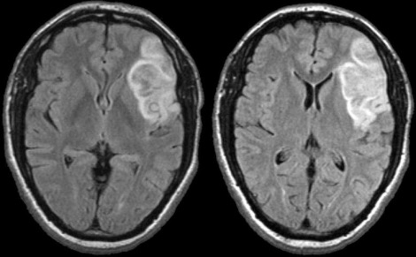
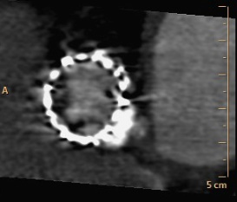
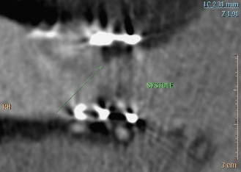
_
_
PATIENT CHARACTERISTICS
Gender
NYHA III or IV
Euroscore I
Diabetes mellitus
Chronic renal failure
Prior surgery
PROCEDURE
CHARACTERISTICS
Non-femoral approach
Implant depth
Type of bioprosthesis
Size of the bioprosthesis
Prior TAVI
Prosthetic regurgitation
Atrial Fibrillation
Anticoagulation at discharge
+
+
+
Long-term Mortality
+
+
+
+
+
+
+
*
*
Bleedings
Cardioembolic Stroke
Bioprosthetic Valve Dysfunction
Notes:
There are multiple independent correlates of long-term mortality and of valve thrombosis after successful TAVI. Interactions are complex. Plain arrows indicate established interactions and dotted arrows loose interactions or interactions that need to be confirmed. The potential clinical benefit of oral anticoagulation is a matter of debate. It varies co-linearly with atrial fibrillation. It is associated with a reduced risk of valve thrombosis. It remains independently associated with mortality despite adjustment for atrial fibrillation. Unknown confounders cannot be excluded and randomized evidences are needed to provide more robust conclusion.

Slide 19
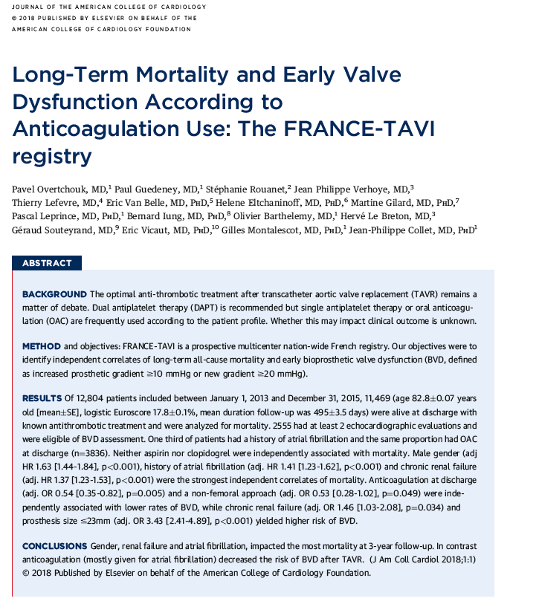
Accepted in JACC
The presentation can be downloaded at action-cœur.org

