Slide 1


Assessment of Dual antiplatelet therapy versus Rivaroxaban In atrial Fibrillation patients Treated with left atrial appendage closure
ADRIFT investigators
DOI public at www.action-coeur.org

Slide 2
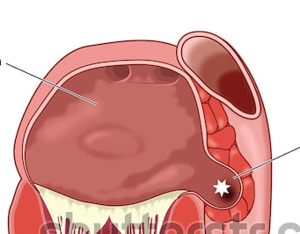
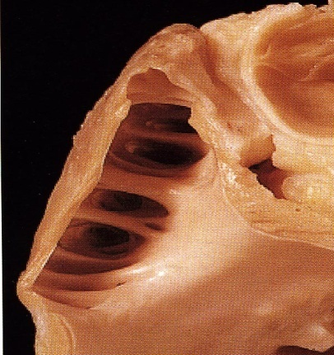
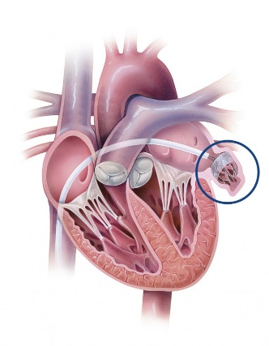

Slide 3
Healing: 30 days to 3 months
Kar et al. JACC Intv 2014;7:801-9

Slide 4
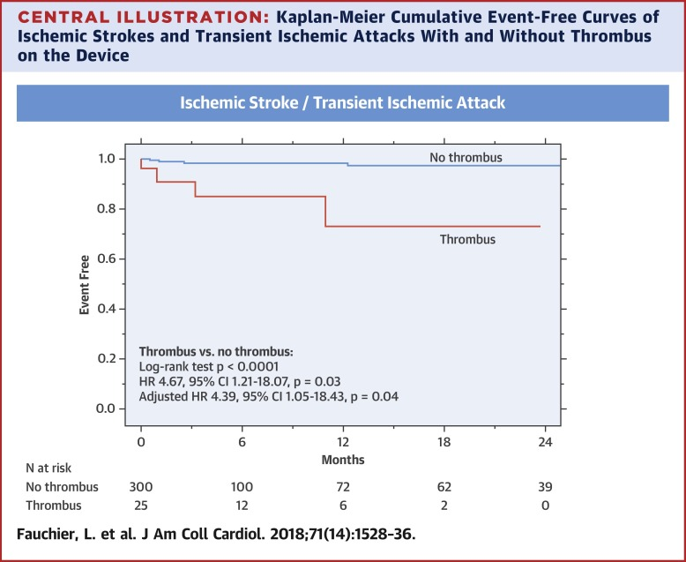

Slide 5
Risk of device thrombosis
Risk factors
Patient-related
DT
CHA2DS2VASc
Spontaneous contrast echo
CHF or low EF
Inflammation
Platelet count
Cancer
Treatment
Device position
Residual leak
Prior stroke
Thrombin
Age
Device-related
Medication-related

Slide 6
Thrombus formation in LA
Venous
thrombotic events
Failure of antithrombotic treatment
Arterial
thrombotic events
Mortality
Lim HS. Effect of atrial fibrillation on atrial thrombogenesis in humans: impact of rate and rhythm. JACC. 2013;61:852-60
Meus R. Prothrombotic State in Patients With a Left Atrial Appendage Thrombus of Unknown Origin and Cerebrovascular Events. Stroke 2016;47:1872-8.
Kamath GS. Activation of the endogenous coagulation system in patients with atrial flutter: relationship to echocardiographic markers of thromboembolic risk. Cardiol J. 2010;17:390-6.

Slide 7
Post-LAAC antithrombotic treatment
Aspirin
Warfarin 45days
Clopidogrel 6 months
No contraindication to anticoagulation
Aspirin
Clopidogrel 3 months
Contraindication to anticoagulation
NOAC 3 months
Holmes et al . JACC 2014;64:1-12

Slide 8
Safety
DAPT vs. warfarin
SAPT vs. NOAC

Slide 9
Study Design
105 patients with successful LAAC
DAPT
Rivaroxaban 15mg od
Randomization 1:1:1
Rivaroxaban 10mg od
1° EP, D10: Thrombin generation (F1+2)
2° EP, D90: F1+2, TAT, D-Dimers and clinical events
Central randomization: CleanWeb® software (Telemedicine Technologies SAS) in a 1:1:1 allocation to rivaroxaban 10 mg (R¹⁰); rivaroxaban 15mg (R¹⁵); DAPT with aspirin 75mg and clopidogrel 75mg.

Slide 10
Objectives
Thrombin generation (F1+2) at Day 10, 2-4 hours after drug intake, on platelet poor plasma (Primary EP)
Thrombin-antithrombin complex, D-Dimers, vWf, PAI-1, Prothrombin time, Rivaroxaban anti-Xa activity, at Day 10 and Day 90 (secondary EP)
Clinical endpoints at Day 90: death, MI, Stroke, peripheral embolism, major or clinically significant bleeding and, device thrombosis

Slide 11
Statistical analyses
Main analysis on the per-protocol population
Complementary ITT and as-treated analyses were performed as sensitivity analyses
Global comparisons among the 3 groups used Kruskall-Wallis non-parametric test
Then a priori defined comparisons between each dose of Rivaroxaban and DAPT were performed using Wilcoxon test or using Chi-square or Fisher’s exact test for binary variables
Nominal p values <0.05 and < 0.016 (Bonferroni’s adjustment) were considered significant for global study and Rivaroxaban vs. DAPT comparisons, respectively

Slide 12
Study organization
Academic Coordinating Center: ACTION, Institute of Cardiology–Pitié-Salpêtrière, Paris
Academic Sponsor: AP-HP, Paris
Academic Global Trial Operations: ACTION, URC-Lariboisière, Paris
Funding: Bayer and ACTION
Investigation sites : 10 French Intervention Centers
Blinded Central Lab for biological measurements
Blinded Central Imaging Lab for echo and CT scans
Blinded Clinical Event Committee for adjudication

Slide 14
Results

Slide 15
Baseline characteristics
 |  | Rivaroxaban 10 mg n=37 | Rivaroxaban 15 mg n=34 | DAPT n=33
Male gender |  | 20 (54%) | 22 (65%) | 23 (70%)
Age (years) |  | 78 ± 8 | 78 ± 9 | 76 ± 8
Heart Failure |  | 6 (16%) | 7 (21%) | 6 (18%)
CHADS₂-VASc Score |  | 4.6 ± 1.3 | 4.7 ± 1.5 | 4.5 ± 1.5
HAS-BLED Score |  | 3.8 ± 1.1 | 3.7 ± 1.0 | 3.5 ± 0.8
Previous Stroke (any) |  | 15 (41%) | 20 (59%) | 15 (45%)
Hemorrhagic |  | 8 (22%) | 4 (12%) | 7 (21%)
Ischemic |  | 4 (11%) | 11 (32%) | 5 (15%)
Hemorrhagic and Ischemic |  | 1 (3%) | 4 (12%) | 3 (9%)
Unknown |  | 2 (5%) | 1 (3%) | 0 (0%)
Previous TIA |  | 2 (5%) | 4 (12%) | 4 (12%)
Permanent contraindication to full anticoagulation |  | 33 (89%) | 30 (88%) | 27 (82%)

Slide 16
Procedural characteristics
 | Rivaroxaban 10 mg n=37 | Rivaroxaban 15 mg n=34 | DAPT n=33
Indication for LAAC (several possible)
Previous major ISTH bleeding | 26 (70%) | 22 (65%) | 22 (67%)
High risk of fall | 8 (22%) | 5 (15%) | 2 (6%)
Labile INRs | 3 (8%) | 2 (6%) | 0 (0%)
Known hemostasis disorder | 0 (0%) | 0 (0%) | 2 (6%)
Stroke recurrence despite adequate anticoagulation | 1 (3%) | 3 (9%) | 3 (9%)
Lack of compliance with anticoagulation therapy | 1 (3%) | 1 (3%) | 0 (0%)
Other contraindication to chronic anticoagulation | 0 (0%) | 1 (3%) | 4 (12%)
Left atrial diameter (mm) | 55 ± 18 | 43 ± 13 | 44 ± 14
Type of LAAC device
Watchman | 12 (32%) | 12 (35%) | 12 (36%)
Amulet | 25 (68%) | 22 (65%) | 21 (64%)
Procedure related complication (any) | 3 (8%) | 2 (6%) | 2 (6%)
Groin hematoma | 2 (5%) | 1 (3%) | 1 (3%)
Blood transfusion and groin hematoma | 0 (0%) | 0 (0%) | 1 (3%)
Pseudoaneurysm | 0 (0%) | 1 (3%) | 0 (0%)
Transfusion | 1 (3%) | 0 (0%) | 0 (0%)

Slide 17
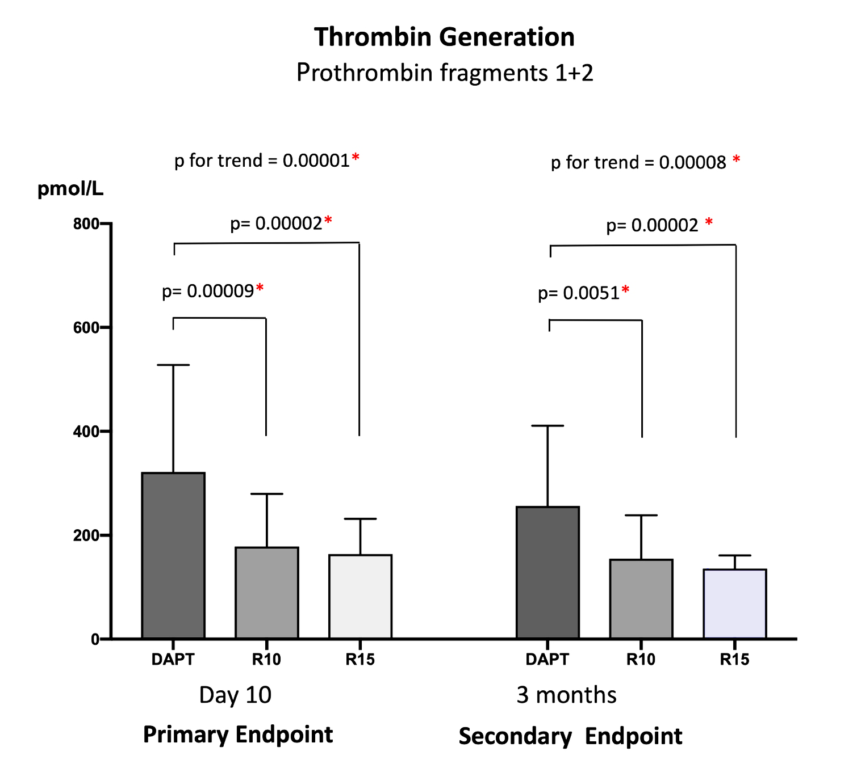
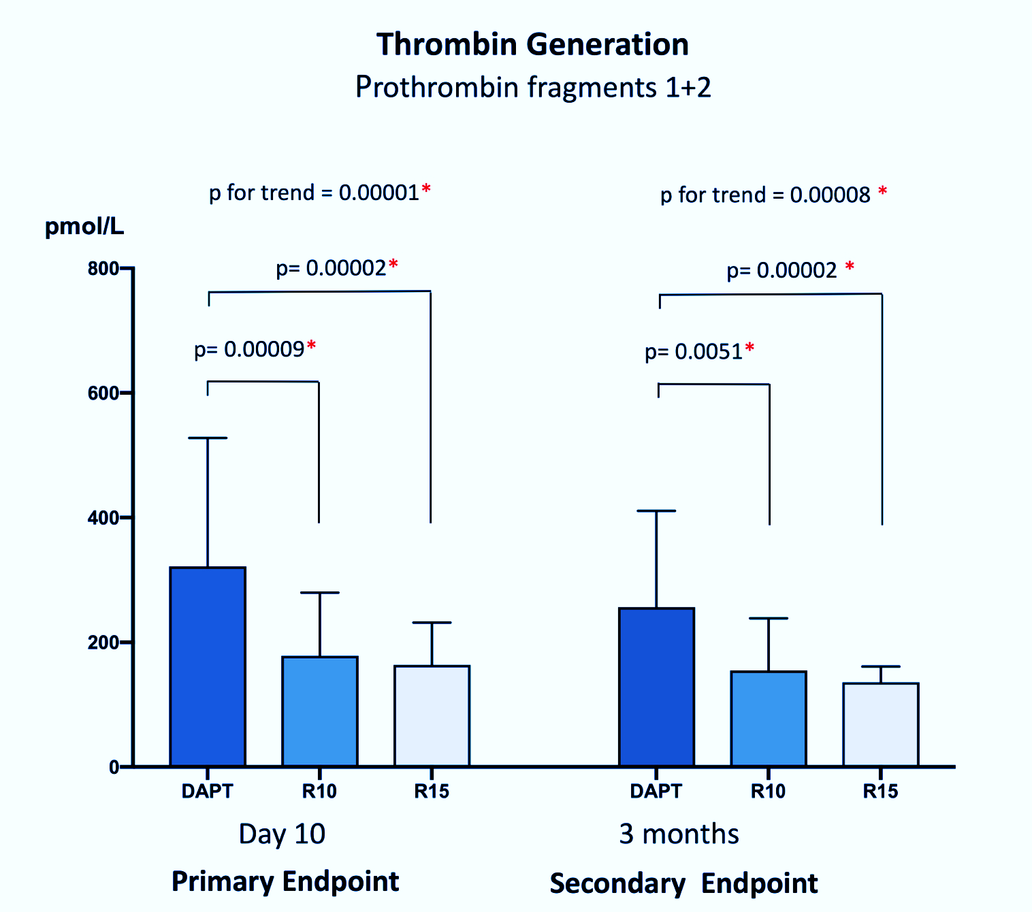
Primary Endpoint
Prothrombin fragments 1+2 @ Day₁₀

Slide 18
Biological endpoints @ day 10
 | Rivaroxaban 10 mg (n=37) | Rivaroxaban 15 mg (n=34) | DAPT (n=33) | p value
TAT (ng/mL) | 3.3 (2.7-4.0) | 3.6 (3.1-5.7) | 4.2 (3.0-7.2) | 0.096
D-Dimers (ng/mL) | 1006 (796-1306) | 1162 (688-1451) | 1213 (949-1472) | 0.286
VWF Ag (%) | 207 (176-295) | 208 (156-273) | 221 (178-265) | 0.982
PAI-1 (UI/mL) | 17 (10-24) | 15 (10-25) | 14 (9-21) | 0.312
Similar trends @ 3 months

Slide 19
Clinical Endpoints @ 3 months
 | Rivaroxaban 10mg n=37 | Rivaroxaban 15mg n=34 | DAPT n=33 | p value
Death | 0 (0%) | 1 (3%) | 0 (0%) | NS
Myocardial infarction | 1 (3%) | 0 (0%) | 0 (0%) | NS
Stroke/TIA | 1 (3%) | 0 (0%) | 0 (0%) | NS
Systemic embolism | 0 (0%) | 0 (0%) | 0 (0%) | -
ISTH Major or clinically significant | 9 (24%) | 4 (11%) | 9 (27%) | NS
TIMI Major | 2 (5%) | 0 (0%) | 1 (3%) | NS
TIMI Minor | 7 (19%) | 4 (12%) | 7 (21%) | NS
TIMI Minimal | 4 (11%) | 8 (23%) | 7 (21%) | NS
Net clinical benefit | 9 (24%) | 5 (15%) | 9 (27%) | NS
Net clinical benefit: Death, Stroke, Myocardial infarction, Systemic embolism, Major or clinically significant ISTH bleeding

Slide 20
Woman, 79y, Amulet 28, DAPT, @3months

Slide 21
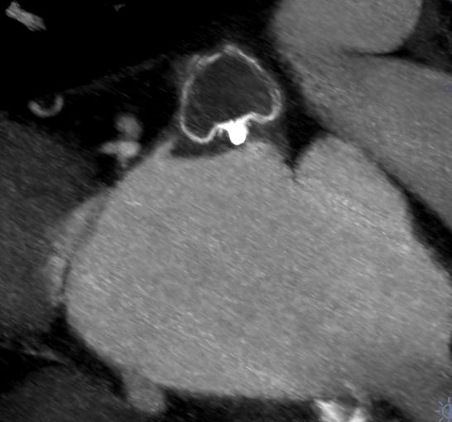
Woman, 69y, Watchman 24, DAPT, @3months
Device
Thrombus

Slide 22
Conclusions
The combined antithrombotic regimens currently used after LAAC may not be adapted to HBR patients undergoing this procedure
A reduced dose of rivaroxaban (monotherapy) is superior to DAPT in controlling thrombin generation
A reduced dose of rivaroxaban appears clinically feasible and deserves further evaluation in large clinical trials.

