Slide 1



There is still a place for thrombolysis in myocardial infarction - CON.
Jean-Philippe COLLET
Sorbonne Université
Action Study Group (action-cœur.org)
Institut de Cardiologie (APHP)
Pitié-Salpêtrière-Paris, France
COI: Dr Collet has nothing to declare with respect to this presentation (action-coeur.org).

Slide 2

The Goal
Coronary recanalisation
Myocardial reperfusion
Reduce myocardial necrosis
LV function preservation
Mortality reduction
2

Slide 3
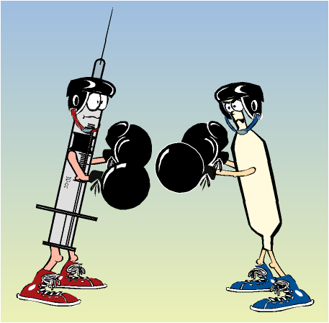

Slide 4


The « lytic » era

Slide 5
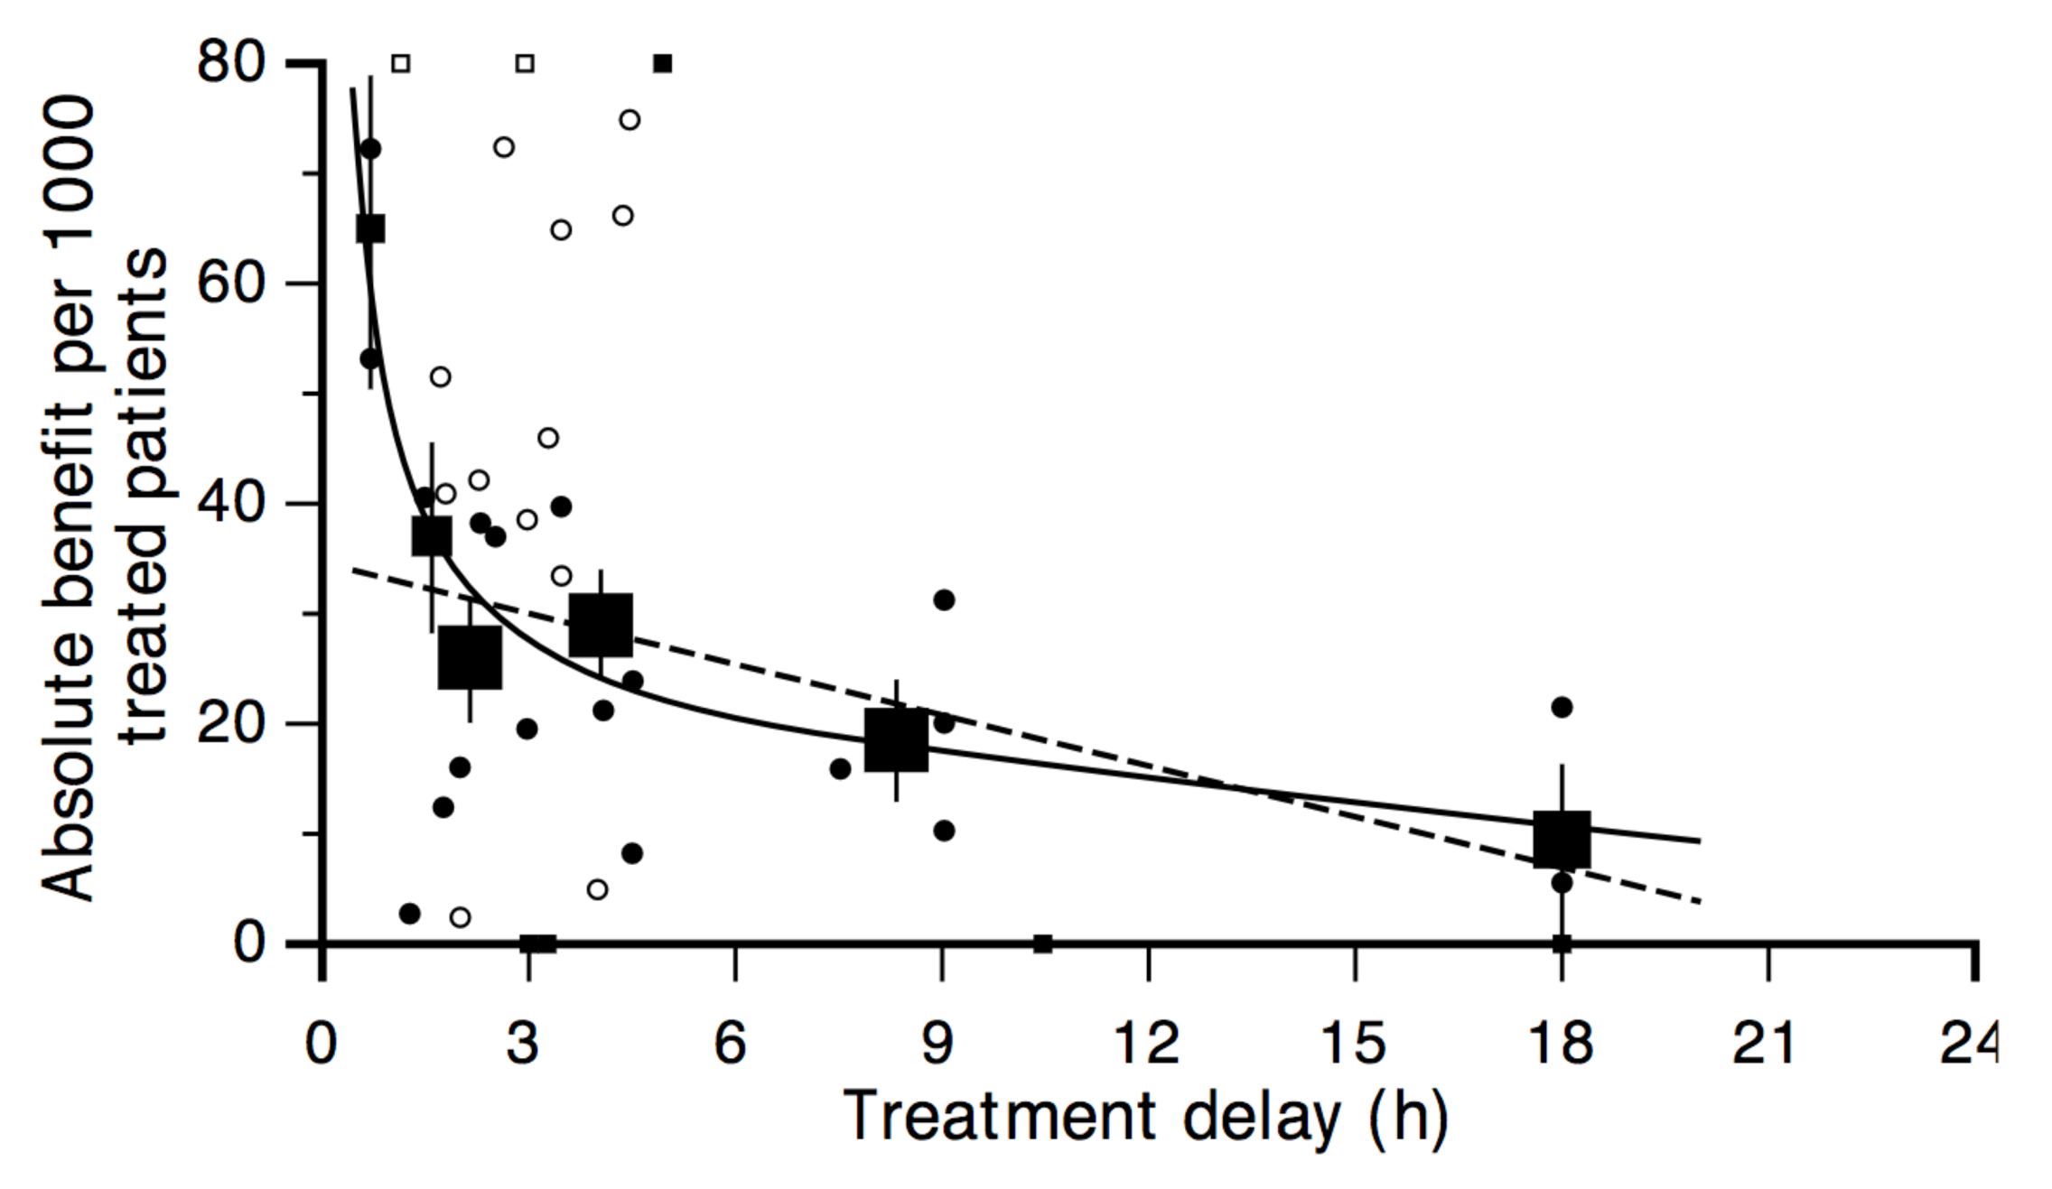
Boersma, Lancet, 1996
Mortality reduction by treatment delay
(N=50.246)
65 (95%CI 38, 93) lives saved per 1000 treated patients vs 26 (14, 37)

Slide 6
The « percutaneous » era

Slide 7
Primary PCI is better than fibrinolysis
Pooled analysis of 23 randomized clinical trials
N = 7739 thrombolytic-eligible patients with STEMI
PPCI (n=3872) or thrombolytic therapy (n=3867)
25
Short-term outcomes
*4-6 weeks
p<0.0001
Incidence (%)
PTCA
20
Thrombolytic therapy
p<0.0001
15
p=0.0002
p=0.0003
p<0.0001
p<0.0004
p<0.0001
p=0.032
10
5
0
50
Long-term outcomes
**6-18 months
p<0.0001
40
30
p=0.0019
p=0.0053
p<0.0001
p<0.0001
20
10
0
*
*
*
Death
Death, excluding
SHOCK data
Non-fatal
myocardial
infarction
Recurrent
ischaemia
Total stroke
Haemorrhagic
stroke
Major bleed
Death, non-fatal
reinfarction,
or stroke
Keeley EC et al. Lancet 2003;361:13-20

Slide 8
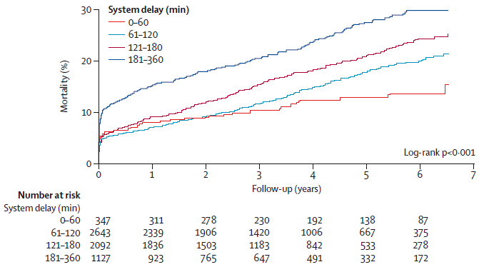
Health-care-system delays* and long-term mortality
has the strongest association with long-term mortality among modifiable acute-phase covariates:
HR of 1·22 (p<0·001) per 1 h increase in system delay.
JAMA 2010; 304: 763–71
*time from first medical contact to primary percutaneous coronary intervention
Notes:
Figure 3: Association between health-care-system delays and long-term mortality
Health-care-system delays (ie, time from fi rst medical contact to primary percutaneous coronary intervention) have the strongest association with long-term mortality among modifi able acute-phase covariates, with a hazard
ratio of 1·22 (p<0·001) per 1 h increase in system delay. Figure reproduced from Terkelsen et al,47 by permission of
the American Medical Association.

Slide 9
Summary

Slide 10
In observational studies, as D2B– D2N* times increase, the advantage of PPCI over fibrinolysis declines…
N =192,509 patients / 645 hospitals
Odds of death for thrombolysis versus PPCI according to time
PPCI better
2.0
Odds of Death With thrombolysis
1.5
1.25
1.0
Lysis better
0.8
0.5
60
75
90
105
114
135
150
165
180
PCI-Related Delay (door-to-balloon/door-to-needle time), minutes
* D2B door-to-balloon / D2N door-to-needle
Pinto DS et al. Circulation 2006;114:2019-25

Slide 11
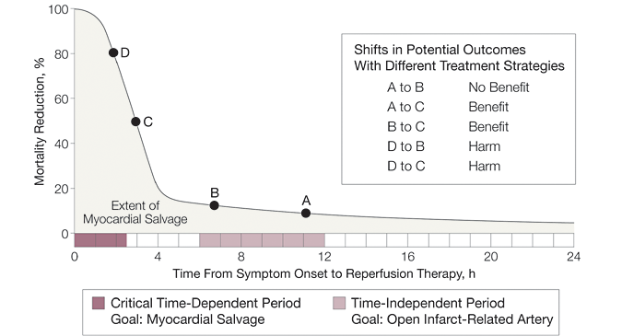


The sooner is the better
Gersh, B. J. et al. JAMA 2005;293:979-986.
Notes:
Figure 2: The association between time to treatment, reduction in mortality, and extent of myocardial salvage
The greatest benefi t gained from reperfusion therapy occurs in the fi rst 2–3 h after symptom onset (shaded dark
blue). The duration of this time-critical period can be modifi ed by factors such as extent of coronary-vessel
collateralisation, myocardial oxygen consumption, total ischaemic time, and ischaemic preconditioning. The gain
in mortality begins to plateau after this period, with time to reperfusion becoming less important. Figure adapted
from Gersh et al5 by permission of the American Medical Association.

Slide 12
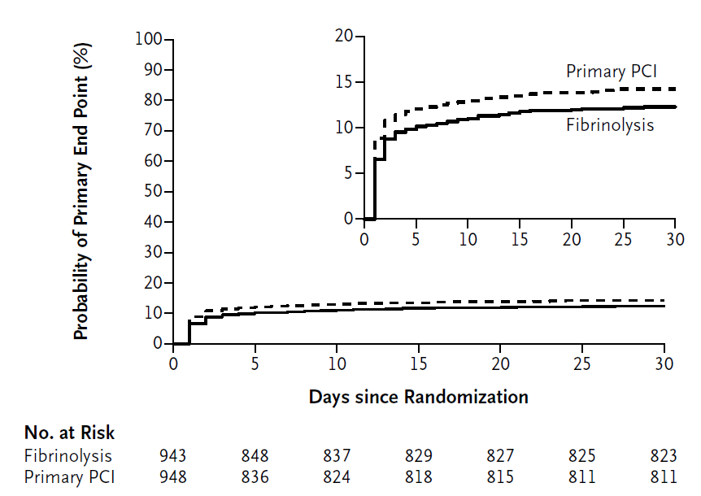
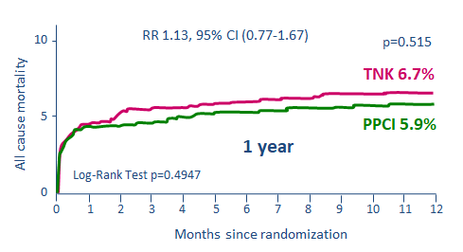
The pharmaco-invasive approach
Dth/Shock/CHF/ReMI (%)
Bleedings | Fibrinolysis (N=944) | PPCI (N=948) | P Value
ICH
Any | 9/939 (1.0) | 2/946 (0.2) | 0.04
After protocol amendment* | 4/747 (0.5) | 2/758 (0.3) | 0.45
Nonintracranial bleeding
Major | 61/939 (6.5) | 45/944 (4.8) | 0.11
Minor | 205/939 (21.8) | 191/944 (20.2) | 0.40
* On August 24, 2009, the study protocol was amended to reduce the dose of TNK by 50% in patients 75 years of age or older because of an excess of intracranial hemorrhage in this age group.
Armstrong PW et al. N Engl J Med 2013;368(15):1379-87
P Sinnaeve AHA 2013
Notes:
Background
It is not known whether prehospital fibrinolysis, coupled with timely coronary angiography,
provides a clinical outcome similar to that with primary percutaneous
coronary intervention (PCI) early after acute ST-segment elevation myocardial infarction
(STEMI).
Methods
Among 1892 patients with STEMI who presented within 3 hours after symptom onset and who were unable to undergo primary PCI within 1 hour, patients were
randomly assigned to undergo either primary PCI or fibrinolytic therapy with bolus tenecteplase (amended to half dose in patients ≥75 years of age), clopidogrel, and
enoxaparin before transport to a PCI-capable hospital. Emergency coronary angiography was performed if fibrinolysis failed; otherwise, angiography was performed
6 to 24 hours after randomization. The primary end point was a composite of death, shock, congestive heart failure, or reinfarction up to 30 days.
Results
The primary end point occurred in 116 of 939 patients (12.4%) in the fibrinolysis group and in 135 of 943 patients (14.3%) in the primary PCI group (relative risk in the
fibrinolysis group, 0.86; 95% confidence interval, 0.68 to 1.09; P = 0.21). Emergency angiography was required in 36.3% of patients in the fibrinolysis group, whereas the
remainder of patients underwent angiography at a median of 17 hours after randomization. More intracranial hemorrhages occurred in the fibrinolysis group than in the
primary PCI group (1.0% vs. 0.2%, P = 0.04; after protocol amendment, 0.5% vs. 0.3%, P = 0.45). The rates of nonintracranial bleeding were similar in the two groups.
Conclusion
Prehospital fibrinolysis with timely coronary angiography resulted in effective reperfusion in patients with early STEMI who could not undergo primary PCI within
1 hour after the first medical contact. However, fibrinolysis was associated with a slightly increased risk of intracranial bleeding. (Funded by Boehringer Ingelheim;
ClinicalTrials.gov number, NCT00623623.)

Slide 13
Whay PCI is better?

Slide 14
ATLANTIC_24h
ECG
ECG
Start
PCI
24 h
?
Aim
The aim of the exploratory ATLANTIC-H24 study was to examine more closely the effects of pre- versus in-hospital ticagrelor on reperfusion, platelet function and clinical endpoints during the first 24 h after primary PCI. The statistical analysis is exploratory.

Slide 15
Post-PCI coronary reperfusion
OR (95% CI):
1.132 (0.876–1.462)
p=0.3440
p=0.049ª
OR (95% CI):
1.225 (0.996–1.506)
p=0.0547
n=760
n=784
n=713
n=743
n=713
n=743
TIMI flow grade 3
in MI culprit vessel
ST-segment
elevation
resolution ≥70%
Degree of ST-segment
elevation resolution
n values are for subjects with PCI performed for the index event and available data on TIMI flow or ST-segment elevation.
ªNon-parametric Wilcoxon test.

Slide 16
Randomized trials
DO IT ALL DURING INDEX
DO IT ALL STAGED
IRA ONLY
ANGIO
GUIDED
FFR
GUIDED
ANGIO
GUIDED
FFR
GUIDED
BASED ON ISCHEMIC SYMPTOMS
PRAMI & CULPRIT
DANAMI
PRIMULTI
COMPARE
ACUTE

Slide 17
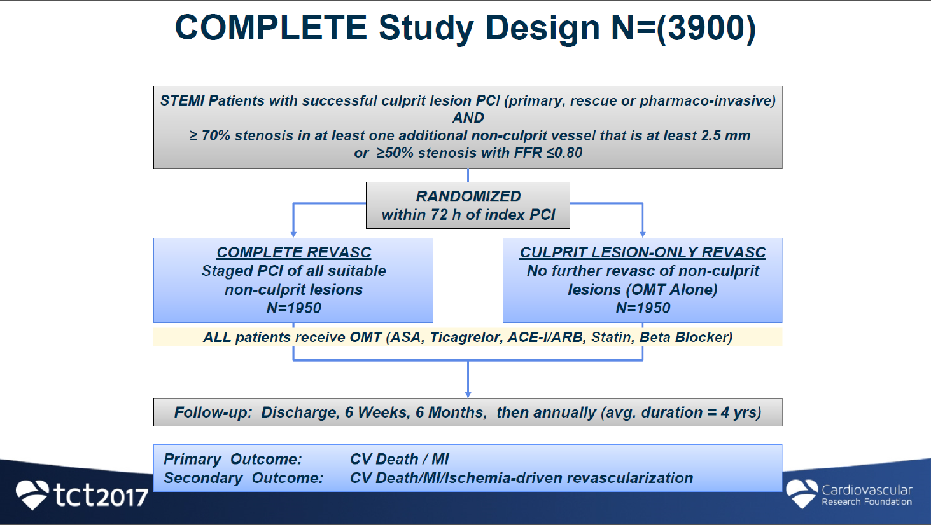

Slide 18

ESC STEMI GUIDELINES
2012-2017

Slide 19


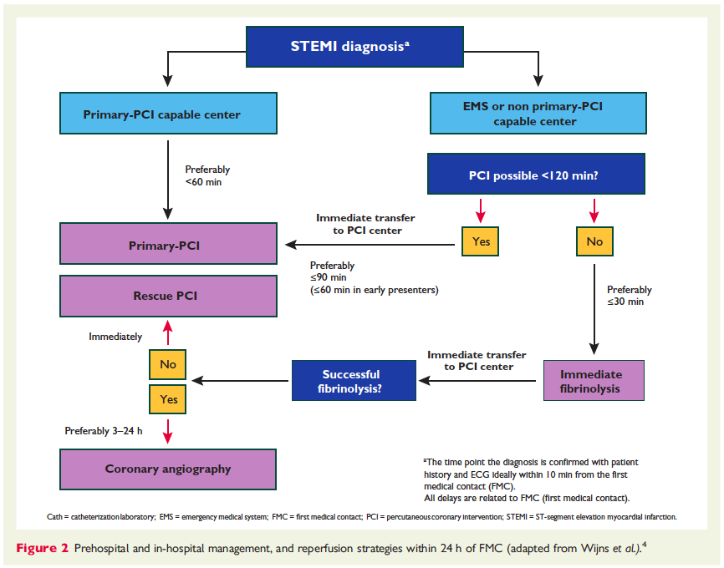
Steg, Eur Heart J, 2012

Slide 20
What is new in 2017 Guidelines on AMI-STEMI
2017 NEW / REVISED CONCEPTS
MINOCA AND QUALITY INDICATORS:
New chapters dedicated to these topics.
STRATEGY SELECTION AND TIME DELAYS:
Clear definition of first medical contact (FMC).
Definition of “time 0” to choose reperfusion strategy (i.e. the strategy clock starts at the time of “STEMI diagnosis”).
Selection of PCI over fibrinolysis: when anticipated delay from “STEMI diagnosis” to wire crossing is ≤120 min.
Maximum delay time from “STEMI diagnosis” to bolus of fibrinolysis agent is set in 10 min.
“Door-to-Balloon” term eliminated from guidelines.
TIME LIMITS FOR ROUTINE OPENING OF AN IRA:
0-12h (Class I); 12-48h (Class IIa); >48h (Class III).
ELECTROCARDIOGRAM AT PRESENTATION:
Left and right bundle branch block considered equal for recommending urgent angiography if ischaemic symptoms.
TIME TO ANGIOGRAPHY AFTER FIBRINOLYSIS:
Timeframe is set in 2-24h after successful fibrinolysis.
PATIENTS TAKING ANTICOAGULANTS:
Acute and chronic management presented.

Slide 21
Modes of patient presentation, components of ischaemic time
and flowchart for reperfusion strategy selection
Total ischaemic time
Patient delay
EMS delay
System delay
FMC: EMS
<10’
Primary
PCI
strategy
<90’
Reperfusion
(Wire crossing)
≤120 min
STEMI
diagnosis
Time
to PCI?
<10’
Fibrinolysis
strategy
<10’
Reperfusion
(Lytic bolus)
>120 min
FMC:
Non-PCI centre
<10’
Primary
PCI
strategy
<60’
Reperfusion
(Wire crossing)
FMC: PCI centre
STEMI
diagnosis
Patient delay
System delay
Total ischaemic time

Slide 22

Modes of patient presentation, components of ischaemic time
and flowchart for reperfusion strategy selection
Total ischaemic time
Patient delay
EMS delay
System delay
Term | Definition
STEMI diagnosis | The time at which the ECG of a patient with ischaemic symptoms is interpreted as presenting ST-segment elevation or equivalent.
FMC: EMS
<10’
Primary
PCI
strategy
<90’
Reperfusion
(Wire crossing)
≤120 min
STEMI
diagnosis
Time
to PCI?
<10’
<10’
Ambiguous terms are eliminated:
“Door-to-balloon”
“Door to door”
>120 min
Fibrinolysis
strategy
Reperfusion
(Lytic bolus)
FMC:
Non-PCI centre
<10’
Primary
PCI
strategy
<60’
Reperfusion
(Wire crossing)
FMC: PCI centre
STEMI
diagnosis
Patient delay
System delay
Total ischaemic time

Slide 23
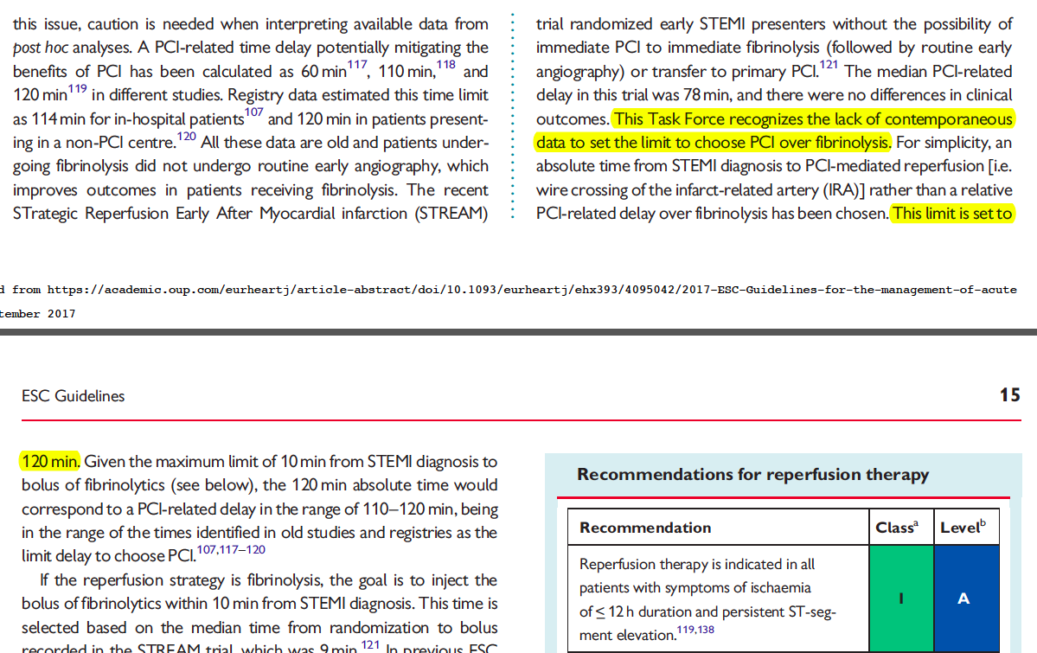

Slide 24
Modes of patient presentation, components of ischaemic time
and flowchart for reperfusion strategy selection
Total ischaemic time
Atypical ECG presentations
Left and right bundle branch block are considered equal for recommending urgent angiography if ischaemic symptoms.
Patient delay
EMS delay
System delay
Bundle branch block,
Ventricular pacing,
Hyper-acute T waves,
Isolated depression in anterior leads,
Universal ST depression with aVR elevationIn
In the presence of symptoms, a primary PCI strategy (urgent angiography and PCI if indicated) should be followed.
FMC: EMS
<10’
Primary
PCI
strategy
<90’
Reperfusion
(Wire crossing)
≤120 min
STEMI
diagnosis
Time
to PCI?
<10’
Fibrinolysis
strategy
<10’
Reperfusion
(Lytic bolus)
>120 min
FMC:
Non-PCI centre
<10’
Primary
PCI
strategy
<60’
Reperfusion
(Wire crossing)
FMC: PCI centre
STEMI
diagnosis
Patient delay
System delay
Total ischaemic time

Slide 25
The MICU prospective

Slide 26

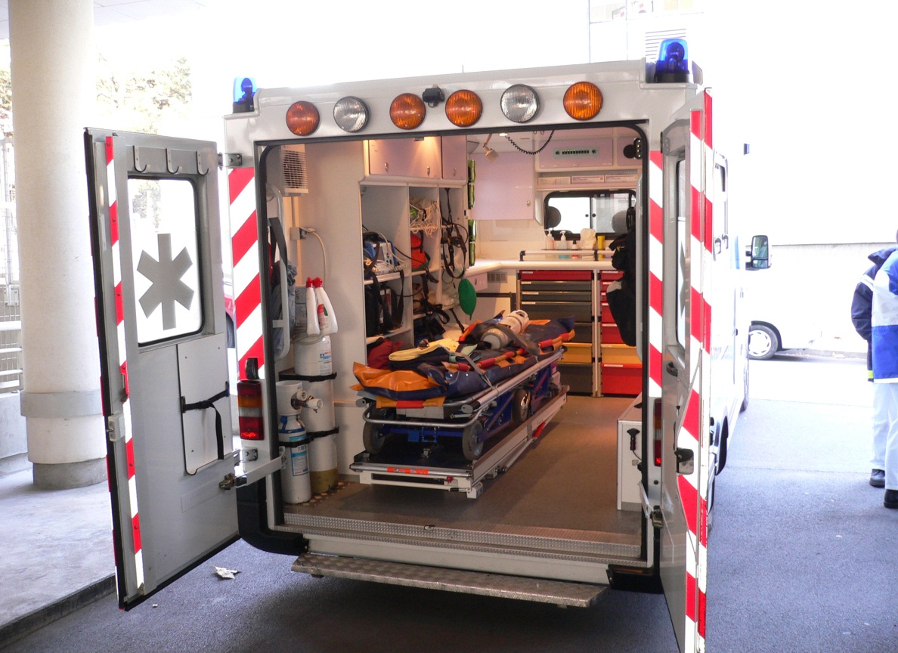
2 MICU = Mobile Intensive Care Unit
DOOR
Patient Diagnosis
Prehospital Treatment
Direct transfer
Impact on clinical trials

Slide 27
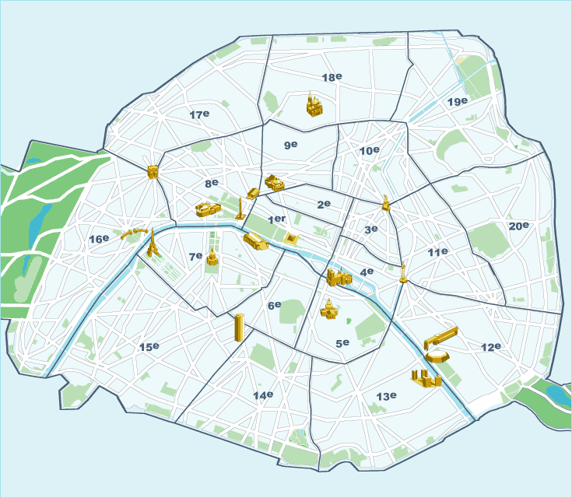
Paris City Public
STEMI Network
Pop = 2 168 000
Higher Density in the East Side ++
PCI 24/24H
Emergency
Dept

Slide 28
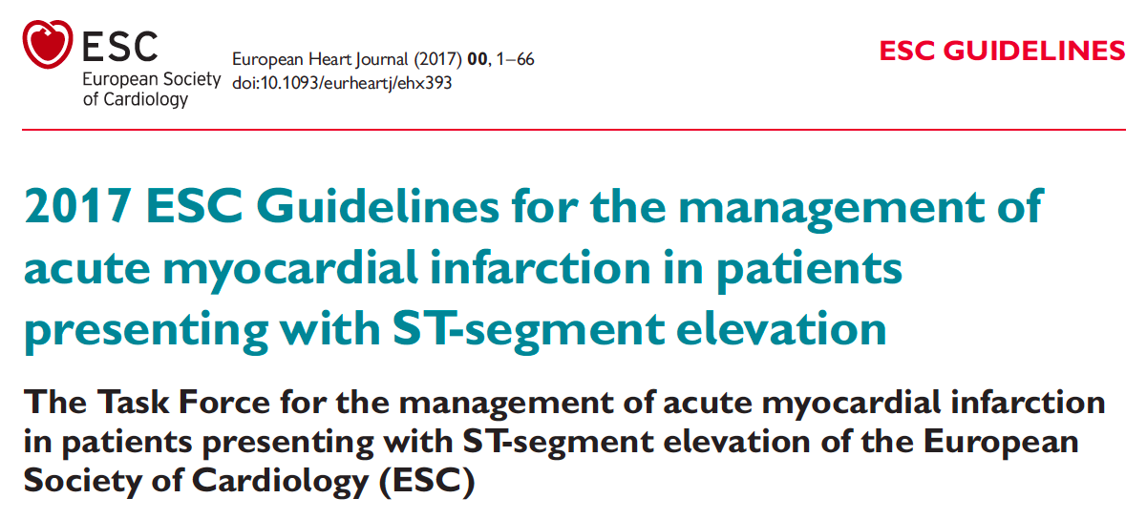


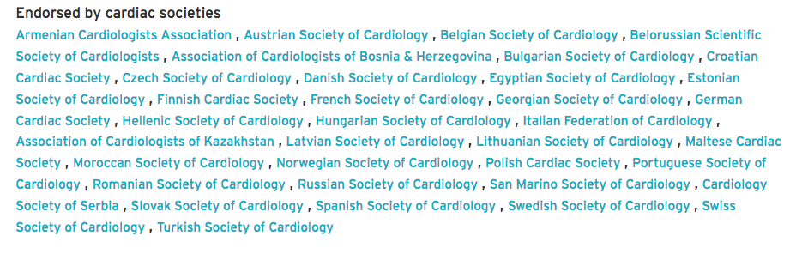
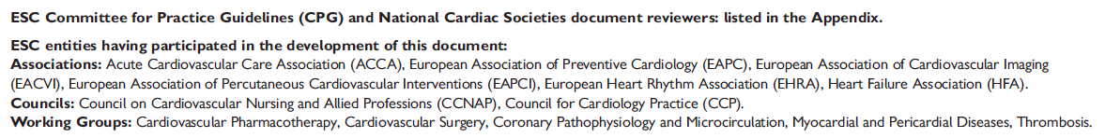
URGENTISTE

Slide 29
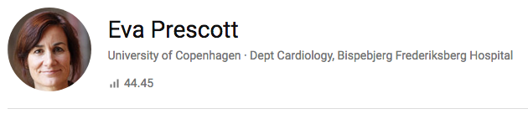



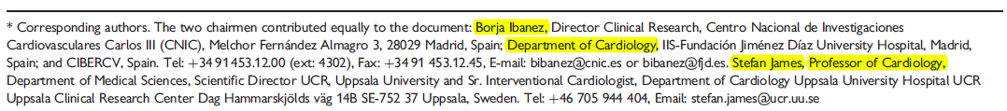
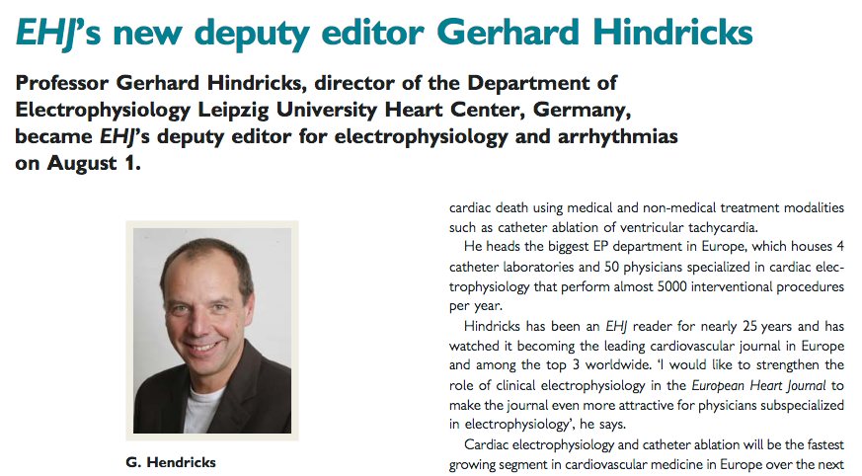


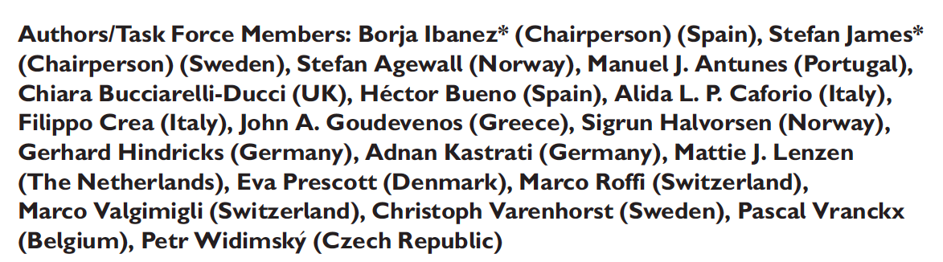
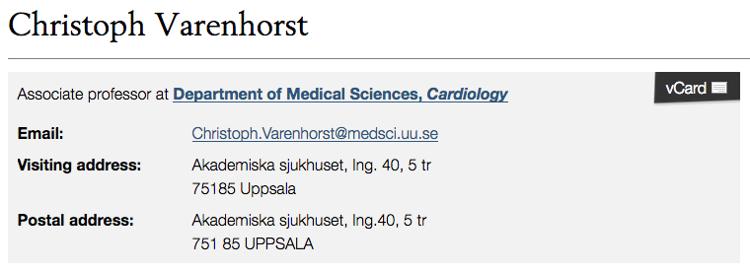


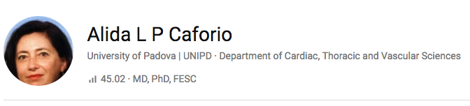
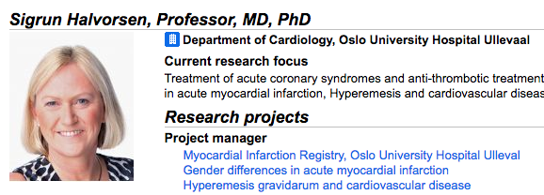
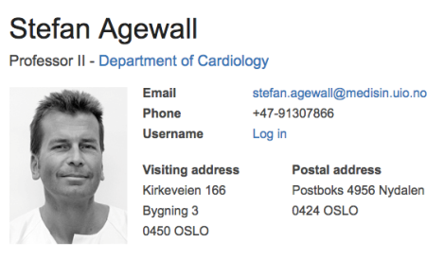
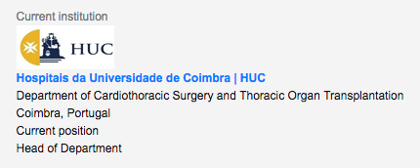



Slide 30

The golden two-hours time delay
Gersh, B. J. et al. JAMA 2005;293:979-986.

Slide 31

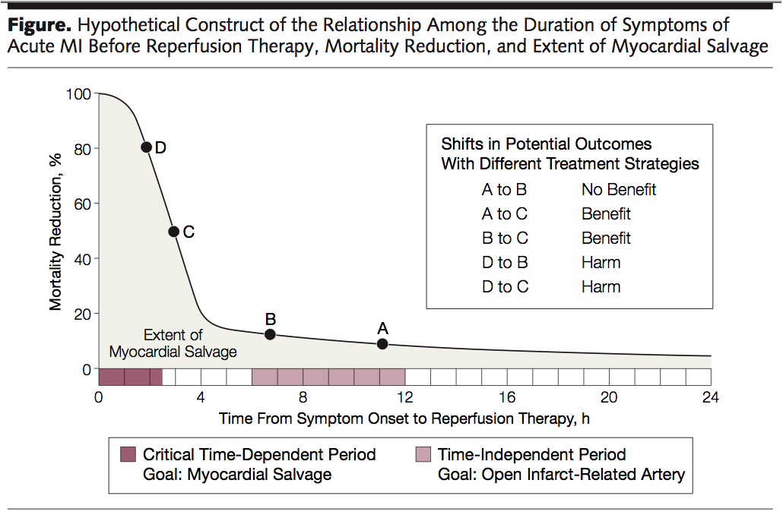
The golden two-hours time delay
Gersh, B. J. et al. JAMA 2005;293:979-986.

Slide 32
MICU-Arguments

Slide 33
« Early presenters » with pPCI in <60 min

Slide 34
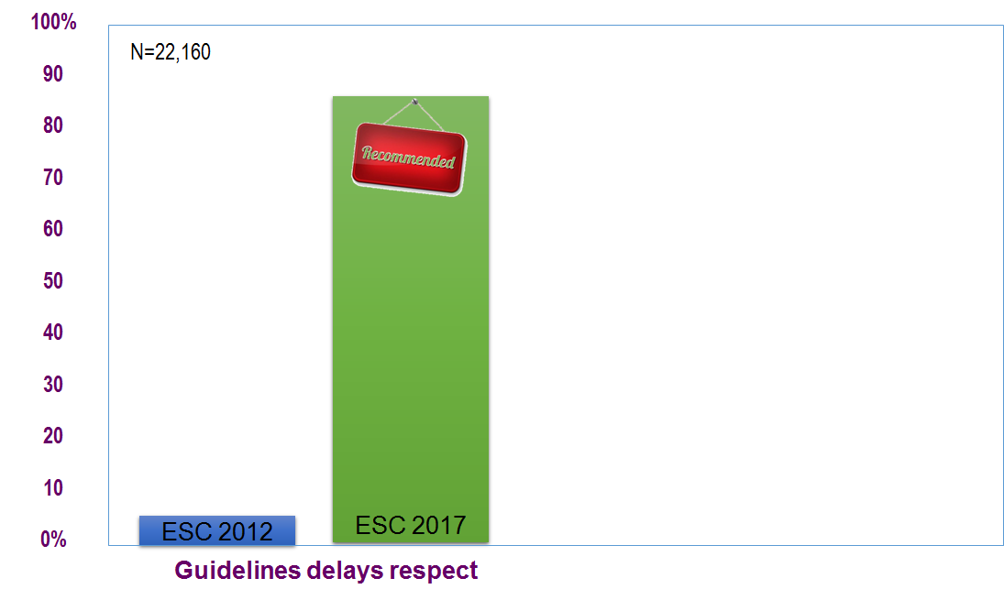
Guidelines Adherence and outcome in STEMI
N=22,160 (2003-2015) → 61% (13,569) of early presenters (<2 hours from SO-FMC)
35% of EP were eligible (n=7684) of whom 2839 had prehospital lytics (<15% of EP)
85.8%
(95% CI: 85.0–86.8%)
5.7%
95% (CI): 5.1–6.2%]
Lapostolle, Eur J Emerg Med, 2019 (in Press)
Notes:
We undertook an analysis of our registry, to compare compliance with the guidelines and patient outcomes with the previous guidelines (2012) and with the new ones (2017) [1,2]. We analyzed data from a prospective, 15-year-old registry of patients with STEMI (<24 h) managed in prehospital settings in the Great Paris area (e-MUST). In accordance with the French SAMU system, patients with STEMI are managed (and thereby included in the registry) by 41 mobile ICUs with an emergency physician on board.
Early presenters (i.e. delay from pain to first medical contact <2 h) who benefitted from a prehospital strategy of primary percutaneous coronary intervention (PCI) were included in our analysis. Patients treated with a pharmacoinvasive strategy (prehospital lytics before PCI), patients who did not benefit from a reperfusion strategy, patients who died before arrival at the hospital and patients for whom information about the delay was missing were excluded.
We then compared the rates of compliance with previous and recent guideline delays reported by physicians (correspondingly the preferred 60 min for ‘early presenters’ in the 2012 guidelines vs. 120 min for all patients in
the 2017 guidelines), and the in-hospital mortality rates corresponding to those delays. These criteria were retrospectively applied to all patients of the cohort. Among 22 160 patients managed in prehospital settings
from 2003 to 2015, 13 569 (61%) were ‘early presenters.’
Among the population of ‘early presenters’, 7684 (35%) were included. Excluded were 2839 patients treated with lytics in a prehospital setting, 637 patients for whom arrival at the hospital and 2393 patients with missing
information about PCI delay.
The rate of patients managed in compliance with the guideline delays (2012 vs. 2017) increased from 5.7 [95% confidence interval (CI): 5.1–6.2%] to 85.8% (95% CI: 85.0–86.8%) [+80.1 (95% CI: 77.7–82.5)] (Fig. 1). The in-hospital mortality rate related to compliance to the 2012 versus 2017 guideline increased from 1.6 (95% CI: 0.4–2.8%) to 3.3% (95% CI: 2.9–3.7%) [+1.7 (95% CI: 0.4–3.0)] (Fig. 1).
The change in delay thresholds allows physicians managing ‘early presenter’ patients with STEMI to report better compliance with the guidelines (86 vs. 6%). Nevertheless, compliance with these new guidelines is associated with an increased mortality rate (3.3 vs. 1.6%). As others have previously demonstrated, and as is demonstrated in this large prehospital registry, STEMI management does not tolerate delay [3,4]. These guideline changes, not supported by any recent literature, as underlined by the authors, aim to simplify patient management. Whatever the guidelines may recommend, physicians should keep in mind that from
pain to reperfusion, ‘time is muscle.’ This is particularly true and critical in the (no longer mentioned) subgroup of ‘early presenters’ managed daily in the prehospital settings

Slide 35
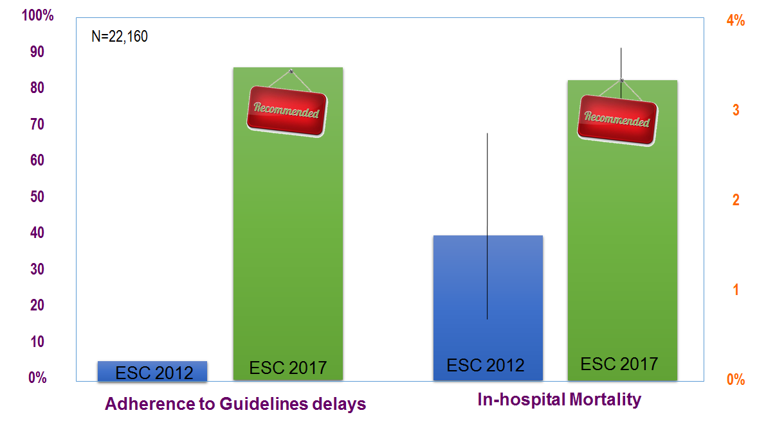
Guidelines Adherence and outcome in STEMI
85.8%
(95% CI: 85.0–86.8%)
3.3%
(95% CI: 2.9–3.7%)
1.6%
(95% CI: 0.4–2.8%)
5.7%
95% (CI): 5.1–6.2%]
Lapostolle, Eur J Emerg Med, 2019 (in Press)
Notes:
We undertook an analysis of our registry, to compare compliance with the guidelines and patient outcomes with the previous guidelines (2012) and with the new ones (2017) [1,2]. We analyzed data from a prospective, 15-year-old registry of patients with STEMI (<24 h) managed in prehospital settings in the Great Paris area (e-MUST). In accordance with the French SAMU system, patients with STEMI are managed (and thereby included in the registry) by 41 mobile ICUs with an emergency physician on board.
Early presenters (i.e. delay from pain to first medical contact <2 h) who benefitted from a prehospital strategy of primary percutaneous coronary intervention (PCI) were included in our analysis. Patients treated with a pharmacoinvasive strategy (prehospital lytics before PCI), patients who did not benefit from a reperfusion strategy, patients who died before arrival at the hospital and patients for whom information about the delay was missing were excluded.
We then compared the rates of compliance with previous and recent guideline delays reported by physicians (correspondingly the preferred 60 min for ‘early presenters’ in the 2012 guidelines vs. 120 min for all patients in
the 2017 guidelines), and the in-hospital mortality rates corresponding to those delays. These criteria were retrospectively applied to all patients of the cohort. Among 22 160 patients managed in prehospital settings
from 2003 to 2015, 13 569 (61%) were ‘early presenters.’
Among the population of ‘early presenters’, 7684 (35%) were included. Excluded were 2839 patients treated with lytics in a prehospital setting, 637 patients for whom arrival at the hospital and 2393 patients with missing
information about PCI delay.
The rate of patients managed in compliance with the guideline delays (2012 vs. 2017) increased from 5.7 [95% confidence interval (CI): 5.1–6.2%] to 85.8% (95% CI: 85.0–86.8%) [+80.1 (95% CI: 77.7–82.5)] (Fig. 1). The in-hospital mortality rate related to compliance to the 2012 versus 2017 guideline increased from 1.6 (95% CI: 0.4–2.8%) to 3.3% (95% CI: 2.9–3.7%) [+1.7 (95% CI: 0.4–3.0)] (Fig. 1).
The change in delay thresholds allows physicians managing ‘early presenter’ patients with STEMI to report better compliance with the guidelines (86 vs. 6%). Nevertheless, compliance with these new guidelines is associated with an increased mortality rate (3.3 vs. 1.6%). As others have previously demonstrated, and as is demonstrated in this large prehospital registry, STEMI management does not tolerate delay [3,4]. These guideline changes, not supported by any recent literature, as underlined by the authors, aim to simplify patient management. Whatever the guidelines may recommend, physicians should keep in mind that from
pain to reperfusion, ‘time is muscle.’ This is particularly true and critical in the (no longer mentioned) subgroup of ‘early presenters’ managed daily in the prehospital settings

Slide 36

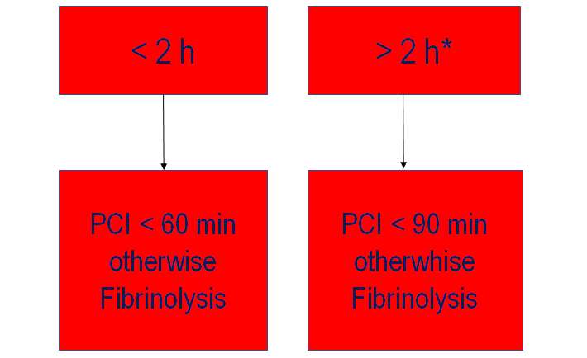
Steg, Eur Heart J, 2012
* More than 4 hours →discuss

Slide 37
What do I see?

Slide 38
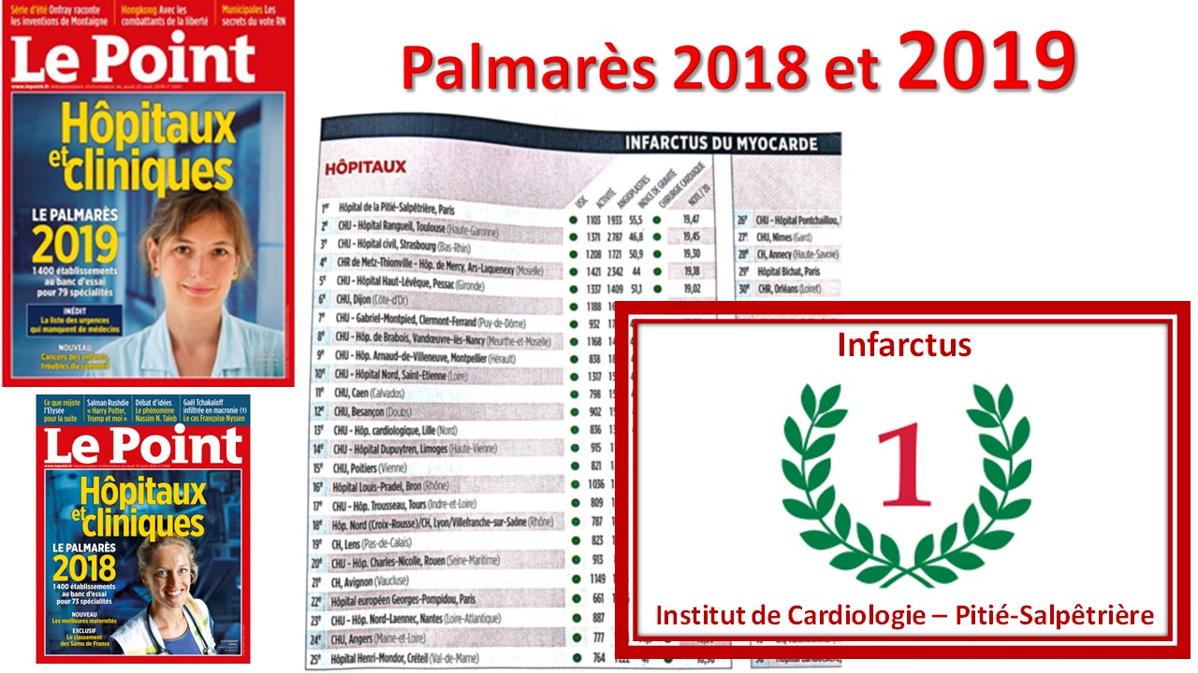

Slide 39
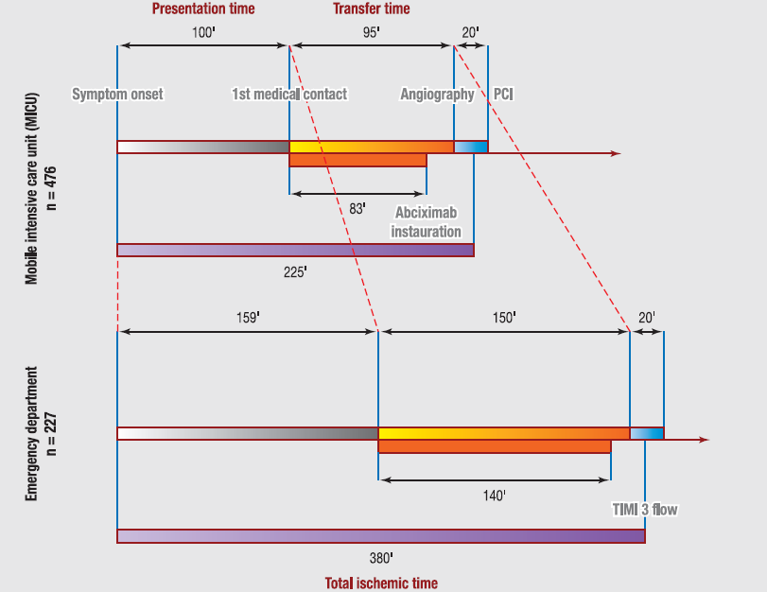
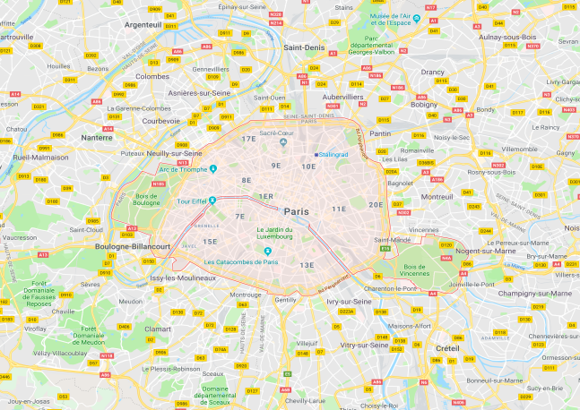
The Pitié-Salpêtrière network experience (2004-2007)
Symptom onset to FMC
<2h : 51,5%
<3h : 62,2%
>4h : 28,4%
EKG- wire
<90 min : 38,5%
<120 min: 61,6%
Archives of Cardiovascular Disease (2012) 105, 639—648
Median PT was 110 minutes (57 min versus 324 min)
Notes:
Median presentation time for the whole study population was 110 minutes (IQR, 51—300) and was 57 minutes (IQR, 30—90) in early presenters (FMC within 2 hours of SO, n = 357) versus 324 minutes (IQR, 195—693) in-late presenters (FMC > 2 hours of SO, n = 349).
Conversely, median transfer time was shorter in early presenters compared with
in-late presenters (95 minutes [IQR, 76—129] vs. 117 minutes
[IQR, 85—196]; P < 0.0001). The more rapid transfer in early
presenters is explained by a higher rate of field triage by
MICU in early presenters who seem to call MICU more frequently
than late presenters who prefer to ‘walk-in’ to the
ED (73.4% vs. 62.9%).

Slide 40
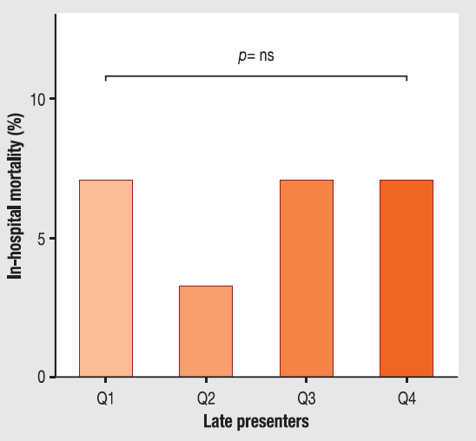
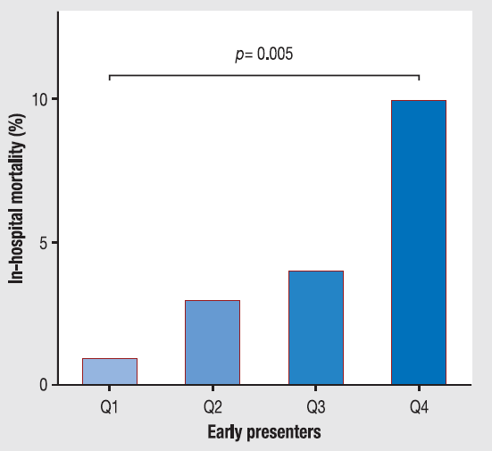
Transfer time (SO-angio) and mortality
≥156 min
<80 min
105-155 min
≥156 min
105-155 min
81-104 min
81-104 min
<80 min
After adjustment for confounding variables such as the severity of patients,
the relationship between mortality and transfer time was no longer apparent.
Archives of Cardiovascular Disease (2012) 105, 639—648
Notes:
Inhospital mortality according to quartiles of transfer
time (symptom onset — angiography) (above) and divided according
to the group of presentation (below). The early presenters
(symptom onset — first medical contact
≤
2 hours) group is on
the left and the late presenters (symptom onset — first medical
contact > 2 hours) group is on the right. ns: not significant.

Slide 41
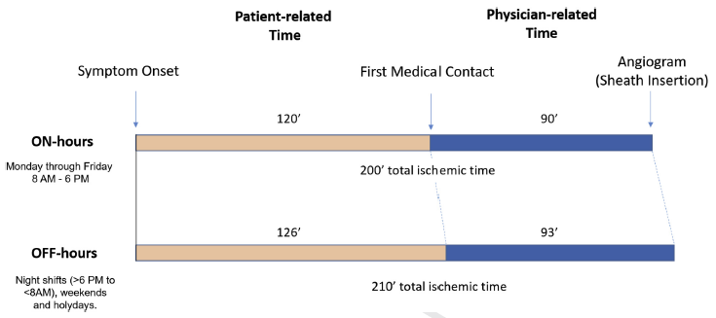
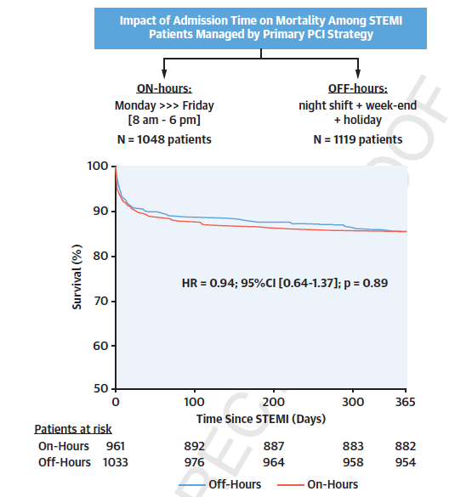
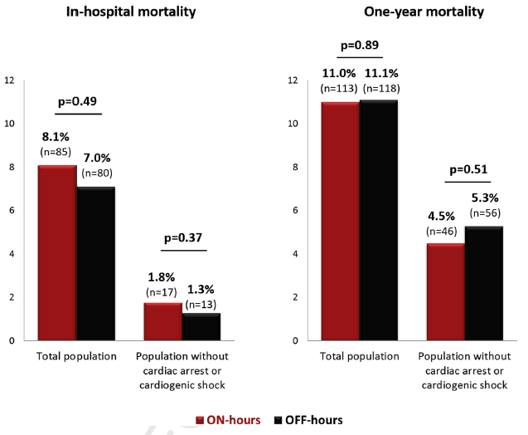
The Pitié-Salpêtrière network experience (2007-2014)
Early Presenters: 22%
Lattuca, B. et al. J Am Coll Cardiol Intv. 2019
Notes:
Age, yrs 62.7
Male sex 1,652 (76.3)
Cardiogenic shock 13%
Cardiac arrest 8%
Radial access 86%
Multivessel disease† 45%
Pre-PCI TIMI 0–1 flow grade 68%
Post-PCI TIMI 3 flow grade 89%

Slide 42
Conclusions
Better myocardial perfusion
Time delay for oral drugs to be active
Pharmaco-invasive is done in less than 10%
Immediate appraisal of the coronary anatomy
The best option for shock

Slide 43

Thank you

Slide 44

There is still a place for thrombolysis in myocardial infarction - CON.
Jean-Philippe COLLET
Sorbonne Université
Action Study Group (action-cœur.org)
Institut de Cardiologie (APHP)
Pitié-Salpêtrière-Paris, France
COI: Dr Collet has nothing to declare with respect to this presentation (action-coeur.org).

Slide 45
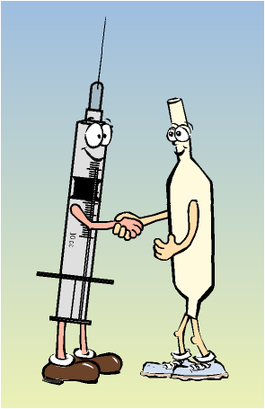
Conclusions

Slide 46


Slide 47
Randomized trials
DO IT ALL DURING INDEX
DO IT ALL STAGED
IRA ONLY
ANGIO
GUIDED
FFR
GUIDED
ANGIO
GUIDED
FFR
GUIDED
BASED ON ISCHEMIC SYMPTOMS
PRAMI & CULPRIT
DANAMI
PRIMULTI
COMPARE
ACUTE

Slide 49
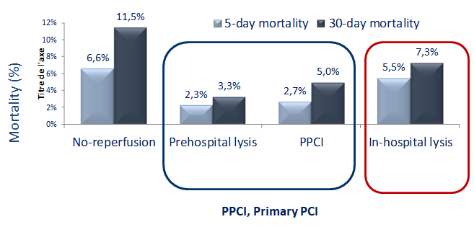
French FAST MI observational registry
Best survival → pre-hospital thrombolysis
FAST-MI (France)
N = 1,714 consecutive definite AMI in ICU over a period of one month (from October 2005)
60% had reperfusion: 33% primary PCI, 29% fibrinolysis (including 18% prehospital)
Danchin N et al. Circulation 2008;118:268-76
Notes:
Background—Intravenous thrombolysis remains a widely used treatment for ST-elevation myocardial infarction; however, it carries a higher risk of reinfarction than primary PCI (PPCI). There are few data comparing PPCI with thrombolysis followed by routine angiography and PCI. The purpose of the present study was to assess contemporary outcomes in ST-elevation myocardial infarction patients, with specific emphasis on comparing a pharmacoinvasive strategy (thrombolysis followed by routine angiography) with PPCI.
Methods and Results—This nationwide registry in France included 223 centers and 1714 patients over a 1-month period at the end of 2005, with 1-year follow-up. Sixty percent of the patients underwent reperfusion therapy, 33% with PPCI and 29% with intravenous thrombolysis (18% prehospital). At baseline, the Global Registry of Acute Coronary Events score was similar in thrombolysis and PPCI patients. Time to initiation of reperfusion therapy was significantly shorter in thrombolysis than in PPCI (median 130 versus 300 minutes). After thrombolysis, 96% of patients had coronary angiography, and 84% had subsequent PCI (58% within 24 hours). In hospital mortality was 4.3% for thrombolysis and 5.0% for PPCI. In patients with thrombolysis, 30-day mortality was 9.2% when PCI was not used and 3.9% when PCI was subsequently performed (4.0% if PCI was performed in the same hospital and 3.3% if performed after transfer to another facility). One-year survival was 94% for thrombolysis and 92% for PPCI (P0.31). After propensity score matching, 1-year survival was 94% and 93%, respectively.
Conclusions—When used early after the onset of symptoms, a pharmacoinvasive strategy that combines thrombolysis with a liberal use of PCI yields early and 1-year survival rates that are comparable to those of PPCI.

Slide 50
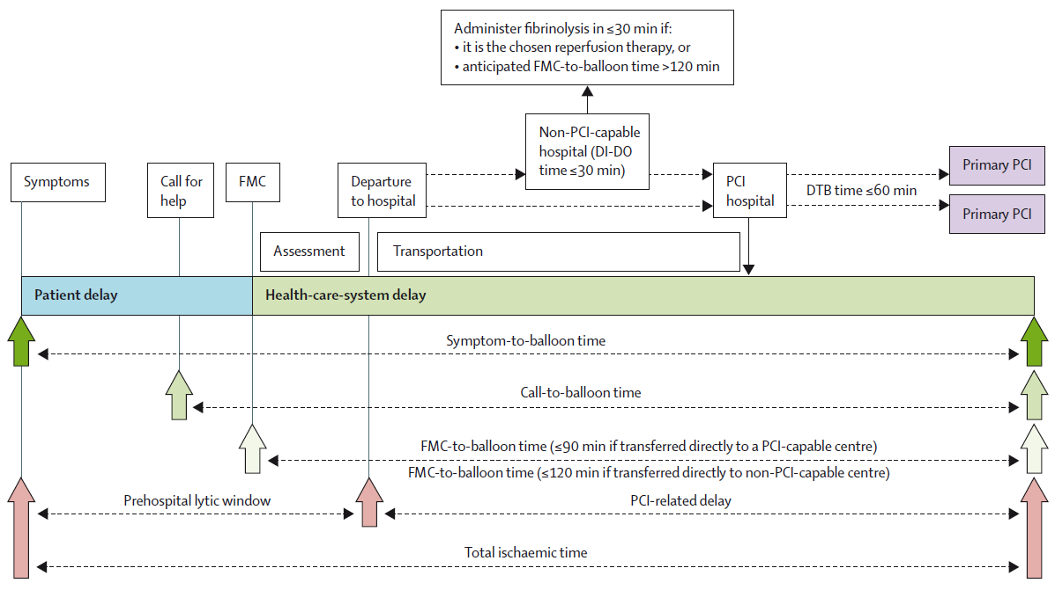
Important timeline metrics in management of STEMI
Lancet 2013; 382: 624–32
Notes:
Figure 1: Important timeline metrics in management of STEMI
Obstacles to reperfusion can be divided into delays related to patients and to the health-care system. PCI-related delay is the extra time needed to do primary angioplasty
rather than give on-scene prehospital thrombolysis. Delay can also occur if the nearest hospital is not PCI capable. Depending on STEMI network infrastructure, the non-PCI
hospital is either bypassed or the patient is taken there fi rst before interhospital transfer to a primary-PCI centre. In addition, a fi brinolytic agent can be given at the
non-PCI-capable hospital. Delay intervals mandated by European and US guidelines are superimposed.1,2 Figure not drawn to scale. Patient-related delays can vary
substantially in length. STEMI=ST-segment elevation myocardial infarction. PCI=percutaneous coronary intervention. FMC=fi rst medical contact. DI-DO=door-in to
door-out. DTB=door to balloon.

Slide 51
One size does not fit all
The acceptable PCI vs thrombolysis related delay depends on patient age, infarct location, and symptom duration
N=192 509 patients
10.614
*Note that guidelines recommend a decision time of 120’ for all patients
20.424
3.739
PCI Related Delay (DB-DN) Where
PCI and Fibrinolytic Mortality Are Equal (Min)
16.119
9.812
41.774
5.296
19.517
Symptoms to FMC
Pinto DS et al. Circulation 2006;114:2019-25
Notes:
Depending on age, duration of symptoms, and infarct location, some patients may actually derive more benefit from fibrinolytic therapy than PCI, even within the 90-minute-or-less door-to-balloon time recommended in current guidelines, while others may actually face lower mortality rates with PCI even if this delay time is longer.
Red figures show the DB-DN delay times at which the survival advantage of PCI over fibrinolysis is lost.
For example, in a young patient under age 65, with an anterior infarction, presenting to the hospital with less than two hours of symptoms, a DB-DN delay time of 40 minutes effectively renders PCI no better than fibrinolysis in terms of reducing mortality.

