Slide 1

ISAR-REACT 5, comment
G. Montalescot
Institute of Cardiology,
Pitié-Salpêtrière Hospital, Paris, France
DOI public at www.action-coeur.org

Slide 2




 | Prasugrel | Ticagrelor
ACS invasive
ACS conservative
Timing in STEMI
Timing in NSTEMI
Wiviott SD et al. NEJM 2007;357:2001-15
Roe MT et al. NEJM 2012;367:1297-309
Montalescot G et al. NEJM 2013;369:999-1010
Wallentin L et al. NEJM 2009;361:1045-57
Montalescot G et al. NEJM 2014;371:1016-27

Slide 3
ACS
ISAR-REACT 5
time
drug
x + 3y - 4z = ?

Slide 4

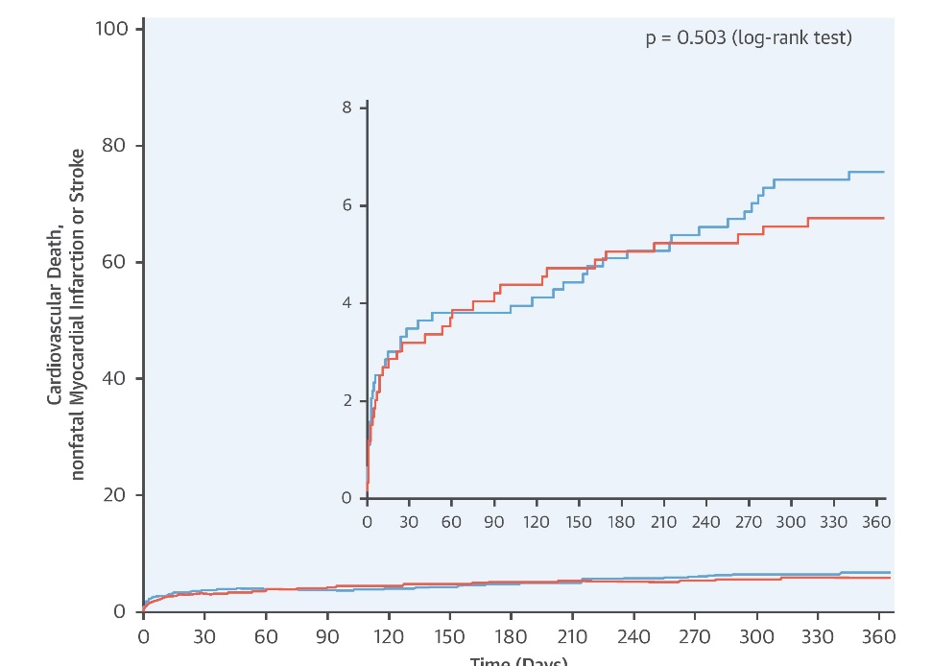
Academic study
Randomized
Stratification by ACS type
Pragmatic
CEC and core labs
Randomization by envelopes
Open label
Not a drug trial
84% PCI
Superiority hypothesis for Tica
13% event rate with prasu and RRR 22.5%
Motovska Z et al. Circulation 2016; 134:1603-1612
Motovska Z et al. J Am Coll Cardiol 2018; 71:371-81
Schulz et al, J Cardiovasc Transl Research 2014;7:91-100

Slide 5

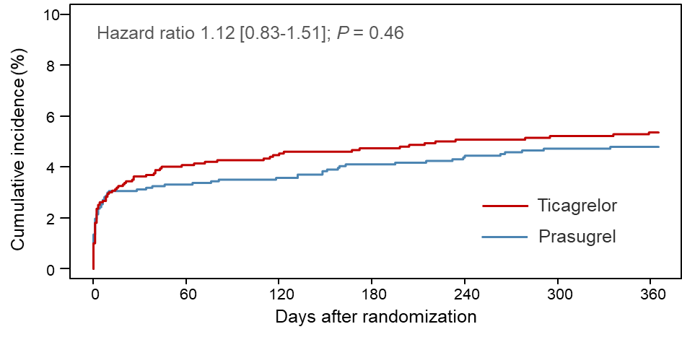

1st thoughts
➔ Informative trial!
Similar safety?
➔ superior timing strategy in NSTEMI!?
Consistency?
➔

Slide 6

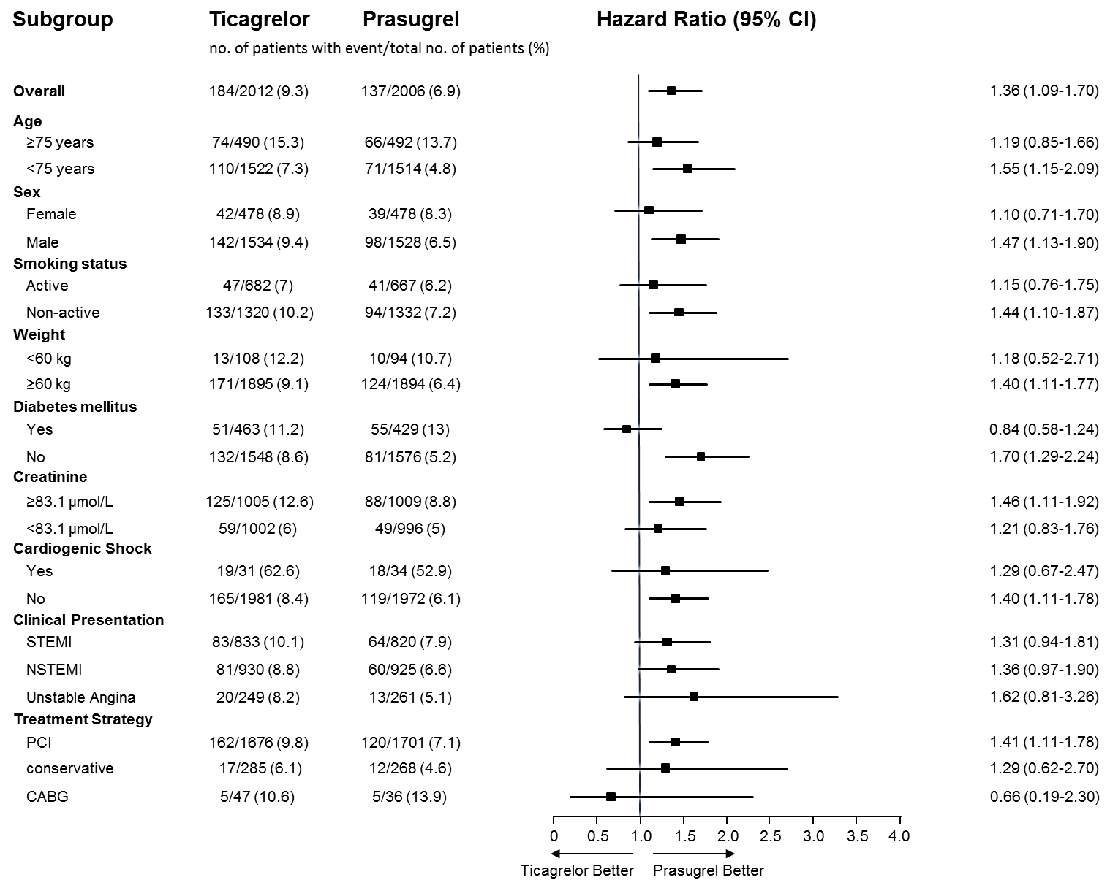



2nd thoughts
One-size fits all strategy (tica) < Individualized strategy (prasu)
Excellent PCI drug (TRITON)
HBR → adjust the dose down (TRILOGY)
Prasugrel 5 mg in patients ≥ 75 years of age or weight < 60 kg
In NSTEMI, do not pre-treat (ACCOAST)

Slide 7
ISAR-REACT 5?
A landmark study!

