Slide 1
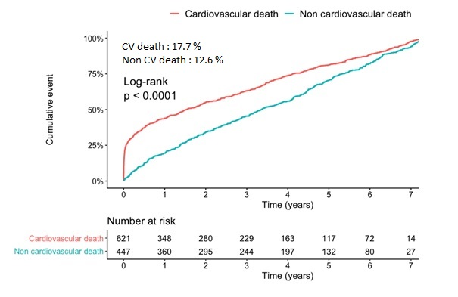
Causes and predictors of short, intermediate and long-term mortality in patients with coronary artery disease
M. Zeitouni, N. Procopi, O. Barthélémy, Q. Fischer, M. Kerneis, N. Hammoudi, E. Berman, R. Choussat, P. Guedeney, N. Braik, JP. Collet, J. Silvain, C. Le Feuvre,
G. Montalescot, G. Helft
Institute of Cardiology, Pitié-Salpêtrière hospital, Paris, France
Abstract
Background: Little is known regarding long-term outcomes related to adverse cardiovascular events and non-cardiovascular events.
Purpose: To describe causes and predictors of short-term, intermediate-term, and long-term mortality after PCI.
Methods: Consecutive men and women admitted for PCI from 2008 to 2011 were prospectively included and followed-up in this cohort study. A pre-established and dedicated follow-up was performed in consultation and by calls to collect outcomes and the exact causes of death. Two independent reviewers adjudicated the events between cardiovascular or non-cardiovascular death. Last detailed cardiovascular and vital status were collected in January 2019.
Results: A total of 3524 patients including 2720 men (77.2%) and 804 women (22.8%) were followed-up for a median time of 7.0 years (IQ1: 5.4 ; IQ3: 7.2). All-cause death occurred for 30.3% (n=1070) of patients in the cohort, in a median time of 2.5 years after PCI, with a rate of 5.3 deaths per 100 patient-years. Overall, patients were more likely to die from a cardiovascular cause than non-cardiovascular (17.7 % versus 12.6 %, log-rank <0.001) (figure 1). This trend was stronger within 30 days (4.7% vs. 0.3 %, p<0.0001) and the first year after PCI (3.1 % vs. 2.2 p =0.01), but became non-significant beyond one year (9.9% vs. 10.2%, P=0.67). Of note, cancer was the major cause of non-cardiovascular death (5.6%; 1 per 100 patient-years) (figure 3). The strongest risk factors for all-cause mortality along time were diabetes (adHR = 1.48 95CI% [1.29 – 1.71], p<0.001), active smoking (adHR = 1.37, 95CI% [1.16 – 1.62]) and chronic kidney disease (adHR = 1.97, 95CI% [2.55 – 3.45], p<0.001).
Table 1. Baseline characteristics
Fig.2 Causes of cardiovascular death
Study Population (N=3524)
Age (years), median, [IQR] | 65.4 [56.9 – 75.7]
Family history of CAD | 617 (17.5%)
Dyslipidemia | 1980 (56.2%)
BMI (kg/m²), median, [IQR] | 25.7 [23.4 – 28.6]
Diabetes mellitus | 1022 (29%)
Hypertension | 2125 (60.3%)
Active smoking | 979 (28.3%)
Chronic kidney disease* | 962 (27.3%)
History of MI or CABG or PCI | 1249 (35.4%)
Clinical presentation
MI | 1876 (53.2%)
Stable angina | 729 (20.7%)
Silent ischemia | 613 (17.4%)
Other | 270 (7.7%)
Angiographic characteristics
Left main | 200 (5.7%)
Left anterior descending | 2263 (34.2%)
Left circumflex | 1632 (46.3%)
Right coronary artery | 1935 (54.9%)
Lesion on CABG | 163 (4.6%)
Number of vessels
1 vessel | 1716 (48.7%)
2 vessels | 1076 (30.5%)
3 vessels | 732 (20.8%)
Multivessel disease | 1809 (51.3%)
Fig.3 Causes of non-cardiovascular death
Fig.1 Cumulative incidence of cardiovascular and non cardiovascular death
Conclusion: In this prospective cohort study, cardiovascular death outer-passed non-cardiovascular death in patients treated with PCI in the short and intermediate-term but not beyond one year. Cancer accounted for one fifth of the overall mortality.
Disclosures : MZ : FFC, Institut Servier, BMS/Pfizer ; MK : FFC, institut servier, NH : Philips, GE healthcare, Bayer, Laboratoires Servier, Novartis Pharma, Astra Zeneca, BMS, MSD, FFC, and ICAN JS : Amed, Amgen, Algorythm, Astra-Zeneca, Bayer, Daiichi-Sankyo, Eli Lilly, Fondation de France, Gilead Science, Iroko Cardio, Sanofi-Aventis and Saint-Jude Medical. JPC :AstraZeneca, Bayer, Bristol-Myers Squibb, Daiichi-Sankyo, Eli-Lilly, Fédération Française de Cardiologie, Lead-Up, Medtronic, MSD, Sanofi-Aventis, WebMD. GM : Abbott, Amgen, Actelion, AstraZeneca, Bayer, Boehringer Ingelheim, Boston-Scientific, Bristol-Myers Squibb, Beth Israel Deaconess Medical, Brigham Women’s Hospital, Cardiovascular Research Foundation, Daiichi-Sankyo, Idorsia, Lilly, Europa, Elsevier, Fédération Française de Cardiologie, ICAN, Medtronic, Journal of the American College of Cardiology, Lead-Up, Menarini, MSD, Novo-Nordisk, Pfizer, Sanofi, Servier, The Mount Sinai School, TIMI Study Group, WebMD.

