Slide 1
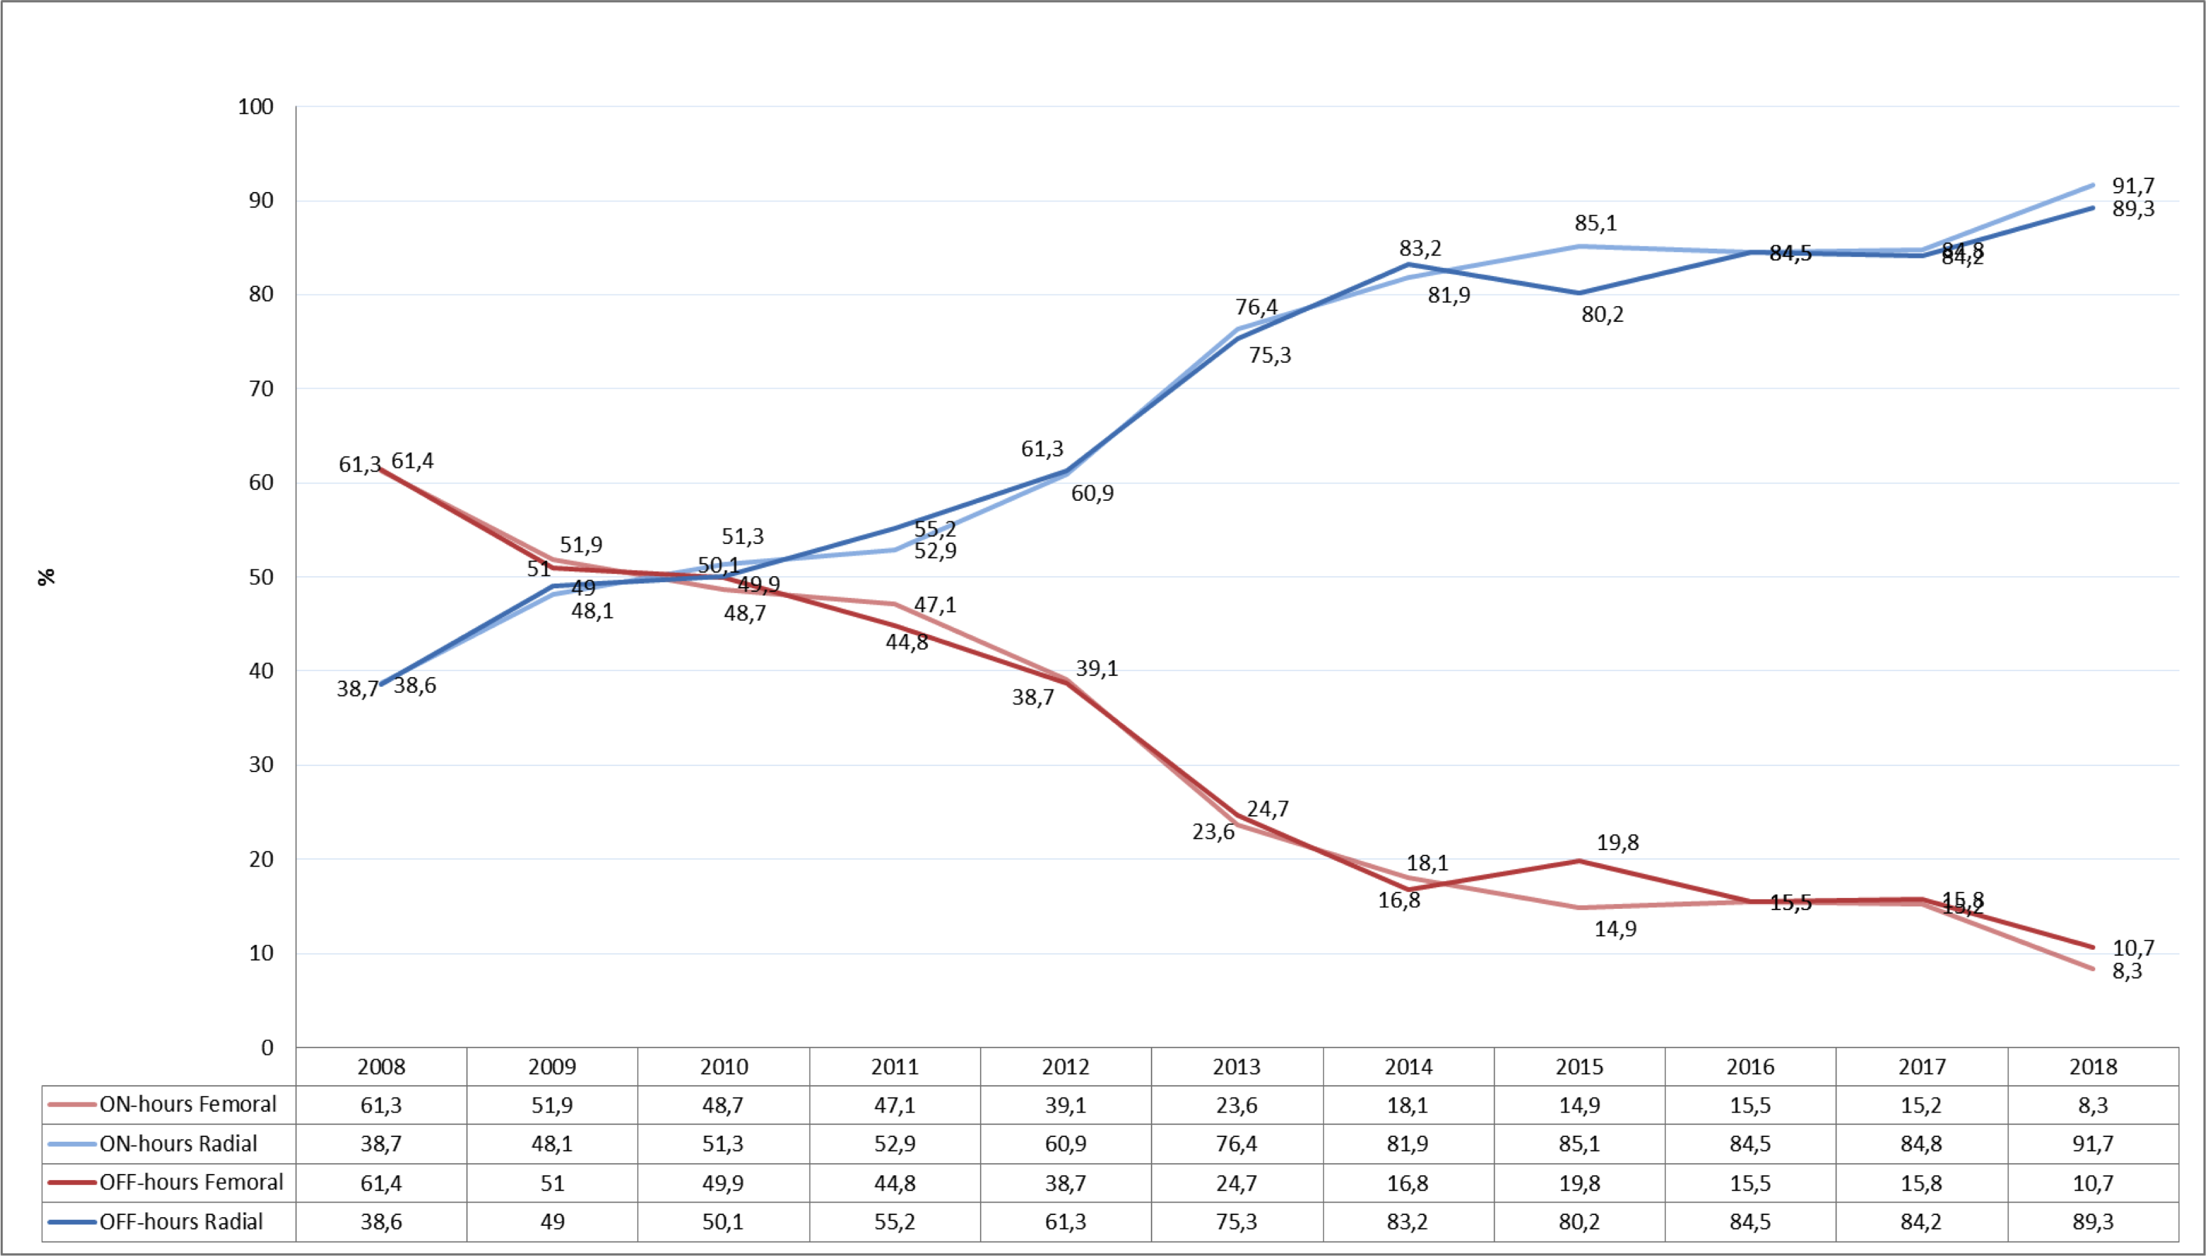
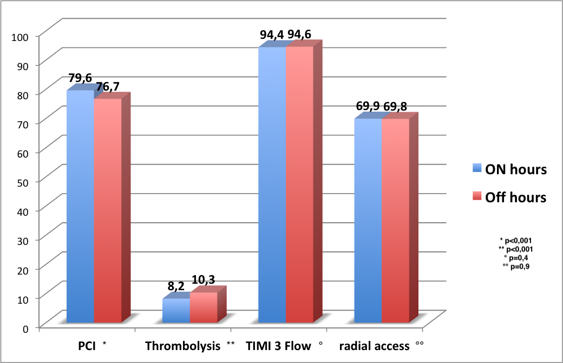
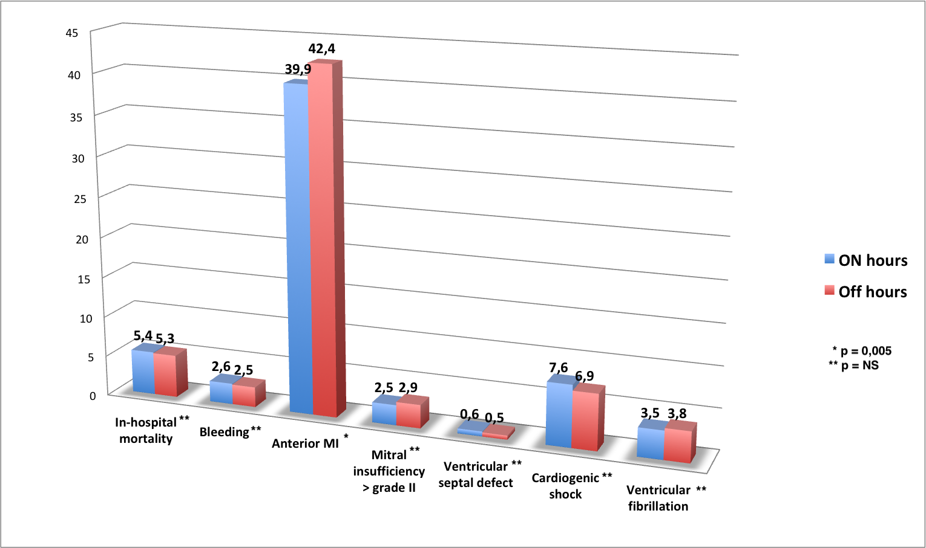
Impact of admission during ON vs. OFF hours on Mortality in STEMI patients in unselected ST-Elevation Myocardial Infarction Patients referred in percutaneous coronary intervention centers : Insights from the ORBI registry.
L Payot MD, A Zabalawi MD, R Delaunay MD , B Moquet MD, JP Hacot MD, T Lognoné MD , G Rouault MD, E Filippi MD , Ph Druelles MD, R Didier MD, Martine Gilard MD-PhD, V Auffret MD , I Coudert MD, T Cherfaoui MD , M Saidani MD, J Treuil MD, B Boulanger MD, L Soulat MD , M Le Guellec MSc, Le Breton H MD-PhD
Abstract
Background
The effect of admission during OFF-hours on patient's outcome in ST Segment Elevation Myocardial Infarction remains controversial when a strategy for reperfusion between primary Percutaneous Coronary Intervention (pPCI) and fibrinolysis is chosen. We aimed to evaluate the impact of time of admission on all cause mortality in unselected STEMI patients referred to pPCI centers.
Methods
Data from 12594 consecutive patients admitted in the nine interventional cardiology centers in Brittany for STEMI in the 24 first hours following the beginning of symptoms were collected in a network registry. Characteristics and clinical outcome of patients admitted during ON-hours (Monday through Friday 8h am-6h30 pm) were compared to OFF-hours patients (night shifts, weekends and non-working holydays). Clinical outcome was all-cause in hospital mortality, major bleeding, and mechanical complications in STEMI.
Results
A total of 7261 confirmed STEMI patients (57.7 %) were admitted during OFF-hours and 5333 (42.3 %) patients during ON-hours. Baseline characteristics were well balanced between the two groups including features of high risk STEMI such as ventricular fibrillation (3.8% vs 3.5 % p =0.5), cardiogenic shock (7.0 % vs 7.6 % p= 0.2), mechanical complications (3.6% vs 3.1%, p=0.3) .
The population was older in the ON group (63.7 ± 13.5 vs 62.2 ± 13.5 p<0.0001).
Time from symptoms onset to First Medical Contact (FMC) were slightly longer for patients presenting during on-hours (96 min vs. 95 min p <0.03). Time from FMC to angiography was longer during OFF-hours compared to ON-hours (100 min vs. 92 min p<0.0001). Time from arrival in the PCI center to angioplasty was higher in the OFF period ( 40 mn vs 37 mn, p<0.0001).
The reperfusion treatment was different between the two periods, with more fibrinolysis and less PCI in OFF group ( PCI : 78.1 % vs 80.6 %, p<0.001; Fibrinolysis : 10.4 % vs 8.2 %, p<0.0001). The use of radial access (RA) was uniform in both group (69,8 % and 69.8 %; p= 0,9) and not different whatever the admission time
The use of radial access increased meaningfully from 2008 for the two periods ( RA OFF group : 89.3% vs 38.6%, RA ON group : 91.7 % vs 38.7%)
There was no impact of admission time on in-hospital all cause mortality in the entire population (5.1% vs 5.2% p =0,7), and on the Timi 3 flow for the patients treated with primary angioplasty ( On group : 94.2% vs 94.6%, p=0.4) . The bleeding complications were similar in both groups (2.4% vs 2.6 %, p=0,6).
Figure 1 :Vascular access evolution since 2008 in the STEMI management in Brittany network registry
Conclusion
Even though the time of reperfusion is slightly longer in patients admitted for STEMI during off-hours, no difference was observed in the PTCA technique and success rates as well as in the in-hospital mortality and bleeding rates. A long term patient follow-up would be necessary before definite conclusions.
Declaration of interest Dr PAYOT : none

