Slide 1
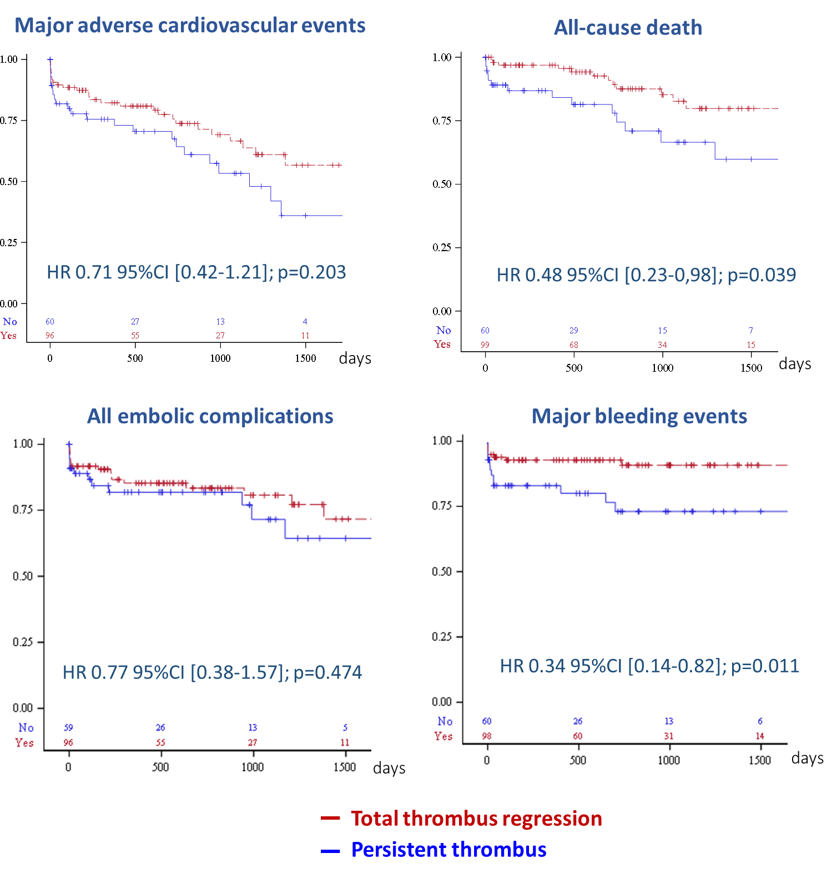
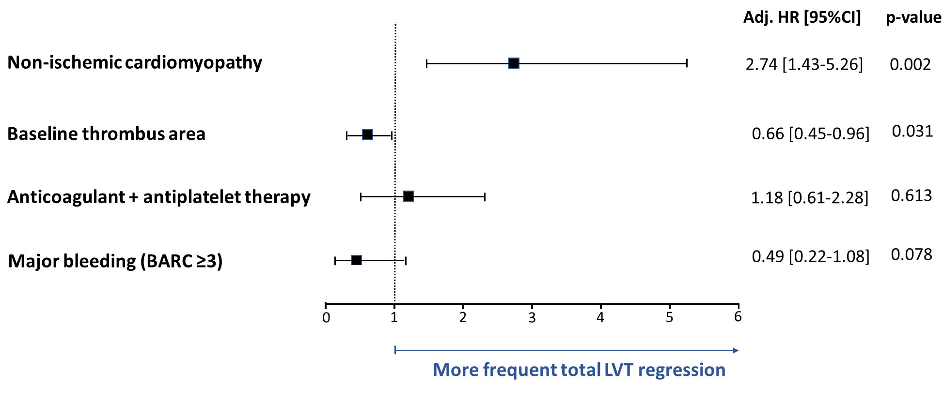
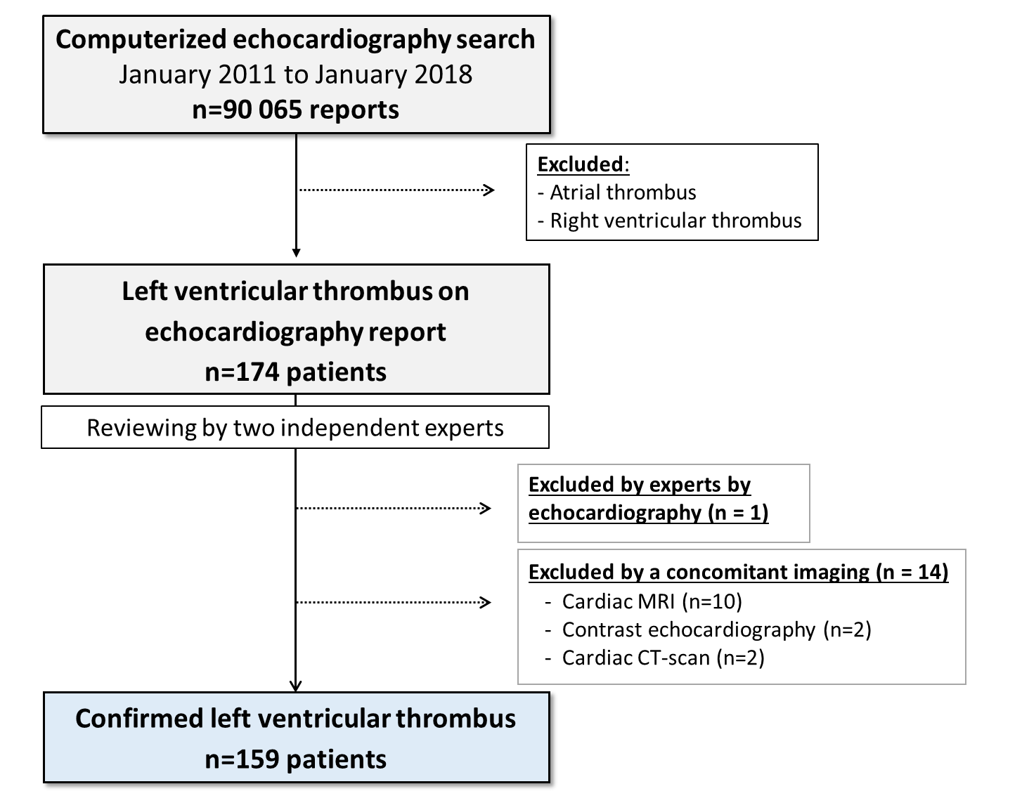
Antithrombotic Therapy and Cardiovascular Events in Patients with
Left Ventricular Thrombus
Benoit Lattuca^{a*}; Nesrine Bouziri^{a*}; Mathieu Kerneisª; Jean-Jacques Portal^{b}; Jioannong Zhou^{c}; Marie Hauguel-Moreauª; Amel Mameriª; Michel Zeitouniª; Paul Guedeneyª;
Nadjib Hammoudiª; Richard Isnardª; Françoise Poussetª; Jean-Philippe Colletª; Eric Vicaut^{b}; Gilles Montalescotª and Johanne Silvain^{a,#} for the ACTION Study Group.
ª Sorbonne Université, ACTION Study Group, INSERM UMR_S 1166, Institut de Cardiologie, Pitié-Salpêtrière Hospital (AP-HP), Paris, France. ^{b} Unité de Recherche Clinique, Lariboisière Hospital (AP-HP), ACTION Study Group, Paris, France.
^{c} Information system department, Pitié-Salpêtrière Hospital (AP-HP), Paris, France. * Both authors contributed equally to this work
Mail to : johanne.silvain@aphp.fr – Poster available at www.action-coeur.org
Background and Purposes:
Contemporary data are lacking on the prognosis and management of left ventricular thrombus (LVT). The purpose of the study was to identify the independent correlates of LVT regression and clinical outcomes.
Results:
We identified 159 patients with a confirmed LVT. The median age was 58±13 years and LVT was related to ischemic cardiomyopathy in 78.5% of the population. Patients were treated by vitamin K antagonists (VKA) (48.4%), parenteral heparins (27.7%) and non-VKA oral anticoagulants (NOACs) (22.6%) with additional antiplatelet therapy in 67.9% of the population. A total LVT regression was reached in 62.3% in a median time of 103 [32-392] days. The independent correlates of LVT regression were a non-ischemic cardiomyopathy and a smaller baseline thrombus.
Methods:
From January 2011 to January 2018, a computerized search of LVT was performed on 90 065 consecutive echocardiogram reports. All patients with a confirmed LVT were included after imaging review by two independent experts. Repeated echocardiographic data, treatment management and major adverse cardiovascular events (MACE), including death, stroke, myocardial infarction or acute peripheral artery emboli were analyzed as well as major bleeding events (BARC≥3) and all-cause mortality.
During the median follow-up of 632 [187-1126] days, cardiovascular events were frequent with occurrence of MACE in 37.1% of the patients.
 | Total (n=159) | Total LVT regression (n=99) | Persistent LVT (n=60) | p value
Major adverse cardiovasc. events | 59 (37.1) | 35 (35.4) | 24 (40.0) | 0.203
Cardiovascular death | 14 (8.8) | 8 (8.1) | 6 (10.0) | 0.434
All-cause death | 30 (18.9) | 15 (15.2) | 15 (25.0) | 0.039
Stroke/TIA | 21 (13.3) | 14 (14.1) | 7 (11.9) | 0.871
Acute peripheral artery emboli | 20 (12.7) | 14 (14.1) | 6 (10.2) | 0.962
All embolic complications | 35 (22.2) | 22 (22.2) | 13 (22.0) | 0.474
BARC ≥ 2 bleeding | 27 (17.0) | 12 (12.1) | 15 (25.0) | 0.002
BARC ≥ 3 bleeding | 21 (13.2) | 9 (9.1) | 12 (20.0) | 0.011
A reduced risk of mortality was observed among patients with
a total LVT regression (HR 0.48; 95%CI [0.23-0.98]; p=0.039).
A left ventricular ejection fraction ≥ 35% (HR 0.46; 95%CI [0.23-0.93], p=0.029) and an anticoagulation therapy > 3 months (HR 0.42; 95%CI [0.20-0.88], p=0.021) were independently associated with a lower rate of MACE.
Conclusions: The presence of LVT was associated with a very high risk of MACE and mortality. Total LVT regression obtained with either VKA, NOACs or heparins led to a better prognosis. Refinement in the antithrombotic management is needed to improve clinical outcomes of these patients.
Disclosures: B. Lattuca has received research grants from Biotronik, Boston Scientific, Daiichi-Sankyo, Fédération Française de Cardiologie and Institute of CardioMetabolism and Nutrition; consultant fees from Daiichi-Sankyo and Eli Lilly; and lecture fees from AstraZeneca and Novartis.

