Slide 1

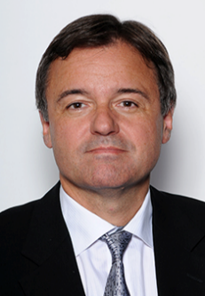
Clinical Case
www.action-cœur.org
Gilles Montalescot
ACTION Study Group, Institute of Cardiology
Pitié-Salpêtrière Hospital
Paris, France

Slide 2
Disclosures
Dr Montalescot reports research grants to the Institution or consulting/lecture fees from Abbott, Amgen, Actelion, American College of Cardiology Foundation, AstraZeneca, Axis-Santé, Bayer, Boston Scientific, Boehringer Ingelheim, Bristol-Myers Squibb, Beth Israel Deaconess Medical, Brigham Women’s Hospital, China Heart House, Daiichi Sankyo, Idorsia, Elsevier, Europa, Fédération Française de Cardiologie, ICAN, Lead-Up, Medtronic, Menarini, MSD, Novo Nordisk, Partners, Pfizer, Quantum Genomics, Sanofi, Servier, WebMD

Slide 3
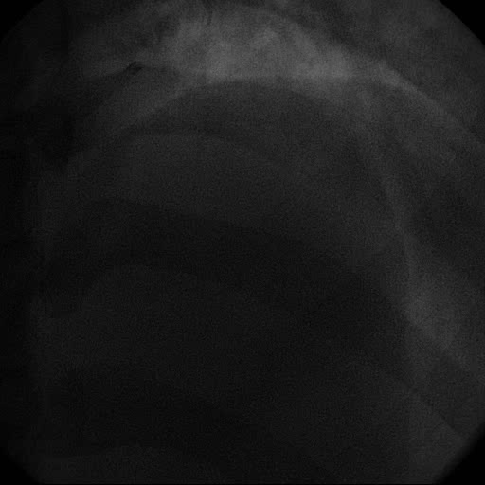


Clinical Case
16 months ago, the 68-year-old patient, a heavy smoker, presented 8 hours after onset of chest pain with anterior MI
  PCI/DES (3.5*30) on single-vessel lesion
Now the patient presents to his primary care physician with fatigue and breathlessness
A physical examination reveals
swelling of both ankles, a rattling
sound in the lungs suggestive of
heart failure
Echocardiography, EF 38%
Notes:
Abbreviations
DES, drug-eluting stent; ECG, electrocardiogram; EF, ejection fraction; MI, myocardial infarction; PCI, percutaneous coronary intervention

Slide 4
Clinical Case (Cont’d)
Improves rapidly on furosemide
Echo-doppler identifies an asymptomatic significant
stenosis of the right carotid artery
Patient still on aspirin + prasugrel
Statins, ACE inhibitors, beta-blockers, furosemide
6 cigarettes a day
LDL 0.58 g/L, HbA1c 5.8%, Hb 15.6 g, creatinine clearance 70 ml/min
BP 110/68 mmHg
Notes:
Abbreviations
ACE, angiotensin-converting enzyme; BP, blood pressure; Hb, haemoglobin; HbA1c, haemoglobin A1c; LDL, low-density lipoprotein

Slide 5
What Would You Do?
Stop prasugrel
Stop aspirin
Aspirin and ticagrelor 60 mg bid
Switch to aspirin and clopidogrel
Replace prasugrel by rivaroxaban 2.5 mg bid
Notes:
Abbreviation
bid, twice daily

Slide 6
Identifying High-Benefit Patients for Dual Pathway Inhibition:
Modified REACH Score/CART Analysis
Ischaemic events* prevented and bleeding events caused per 1000 patients over 30 months with addition of rivaroxaban 2.5 mg bid to aspirin in high-risk groups
Additional severe bleeds
High-benefit groups: polyvascular disease; HF; eGFR <60 ml/min; diabetes
*Secondary efficacy outcome
Anand SS et al, J Am Coll Cardiol 2019;73:3271–3280
Notes:
Abbreviations
ALI, acute limb ischaemia; bid, twice daily; eGFR, estimated glomerular filtration rate; HF, heart failure; MACE, major adverse cardiovascular events

Slide 7
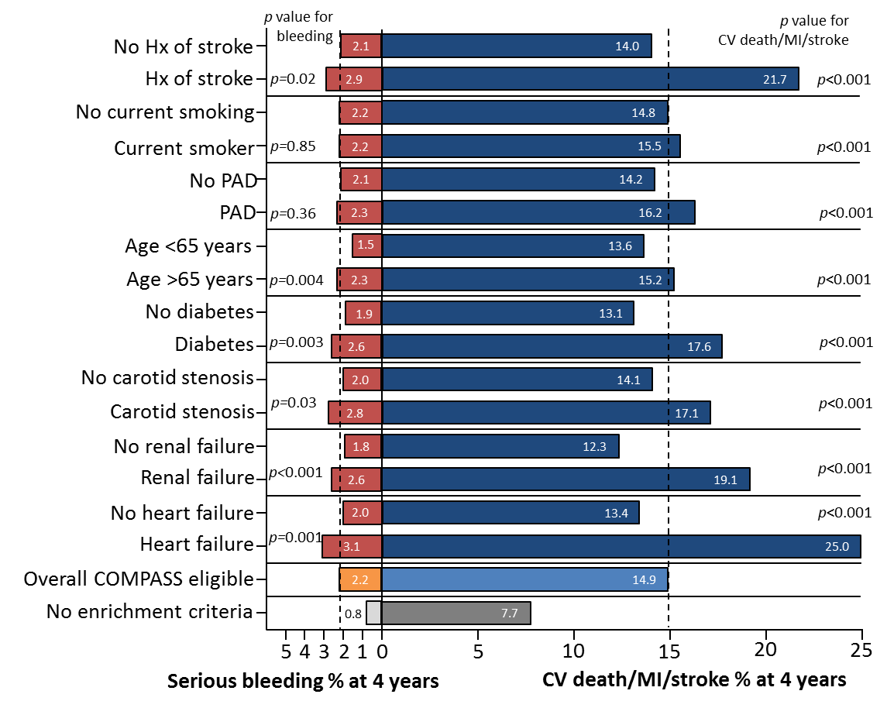
4-Year Rates of Primary Ischemic and Secondary Bleeding Outcomes According to COMPASS Enrichment Criteria in the REACH Population Eligible for Enrolment in COMPASS
Darmon A et al, JACC 2019;73:3281–3291

Slide 8
Identifying High-Benefit Patients for Dual Pathway Inhibition:
Enrichment Criteria
Ischaemic and bleeding outcomes in COMPASS-eligible patients in the REACH registry according to the number of enrichment criteria¹
Enrichment criteria:
Age >65 years old
Smoking
Diabetes
Renal dysfunction
HF
Carotid disease
PAD
Prior stroke
Darmon A et al, JACC 2019;73:3281–3291
Notes:
Abbreviations
CV, cardiovascular; HF, heart failure; MI, myocardial infarction; PAD, peripheral artery disease

Slide 9

Decision-Making in Clinical Practice
A Proposed Pathway
Indication for full anticoagulation
Anaemia
Bleeding diathesis
Prior ICH
Uncontrolled HT
Liver disease
Prior hospitalization for bleeding
Extreme old age or frailty
CAD patients and no high bleeding risk
Optimal risk factor control
Medical treatment or CABG
PCI
ACS
CCS or ACS
DAPT up to 12 months
CCS
Assessment of thrombotic risks
High stent-related risk:
LM stenting
Bifurcation
Multiple/long stenting
Small arteries
Prior stent thrombosis
Multi-vessel CAD or prior MI and one of the following:
≥2 vascular beds
Stable HF
Type II diabetes
eGFR <60 ml/min
Low ischaemic risk
Example pathway intended for discussion only and not as a suggestion of best practice
Continue DAPT
(ticagrelor 60 mg bid or clopidogrel)
Rivaroxaban
2.5 mg bid
+ aspirin*
SAPT
(aspirin or clopidogrel)
*No requirement for DAPT
Notes:
Please note that this patient pathway was developed based on outputs from the Vascular Protection Initiative and should be used as an aid for discussion around the physician's own experience, rather than as a suggestion of best practice.
Abbreviations
ACS, acute coronary syndrome; bid, twice daily; CABG, coronary artery bypass grafting; CAD, coronary artery disease; CCS, chronic coronary syndrome; DAPT, dual antiplatelet therapy; eGFR, estimated glomerular filtration rate; HF, heart failure; HT, hypertension; ICH, intracerebral haemorrhage; LM, left main; MI, myocardial infarction; PAD, peripheral artery disease; PCI, percutaneous coronary intervention; SAPT, single antiplatelet therapy

